Slide 1
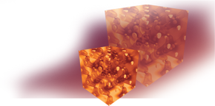
Applications of QMC to Geophysics
Ronald Cohen
Geophysical Laboratory
Carnegie Institution of Washington
cohen@gl.ciw.edu
QMC Summer School 2012 UIUC

Slide 2
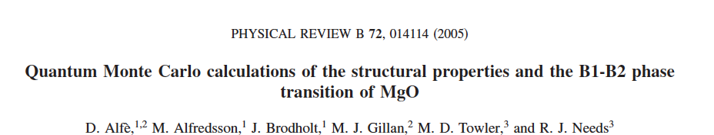
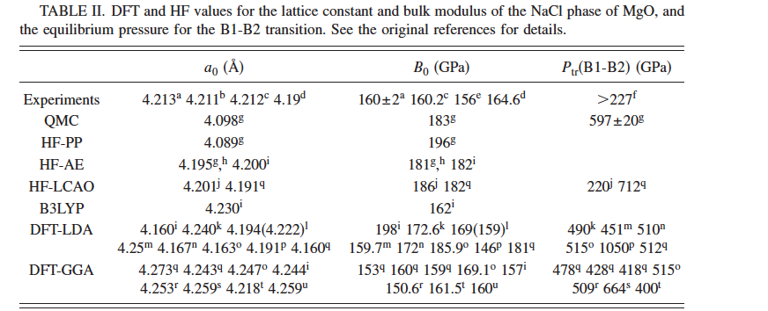

Slide 3
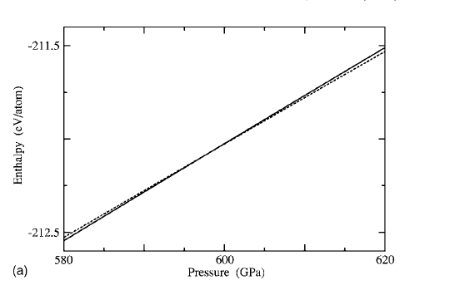
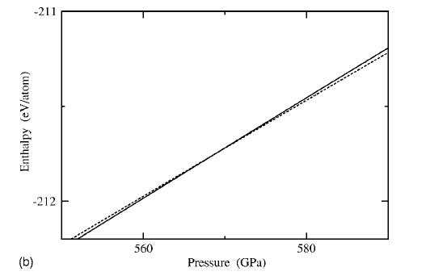
DMC
LDA
Enthalpy, MgO, B1 to B2

Slide 4
DFT generally works well, but can unexpectedly fail even in “simple” systems like silica

Slide 5
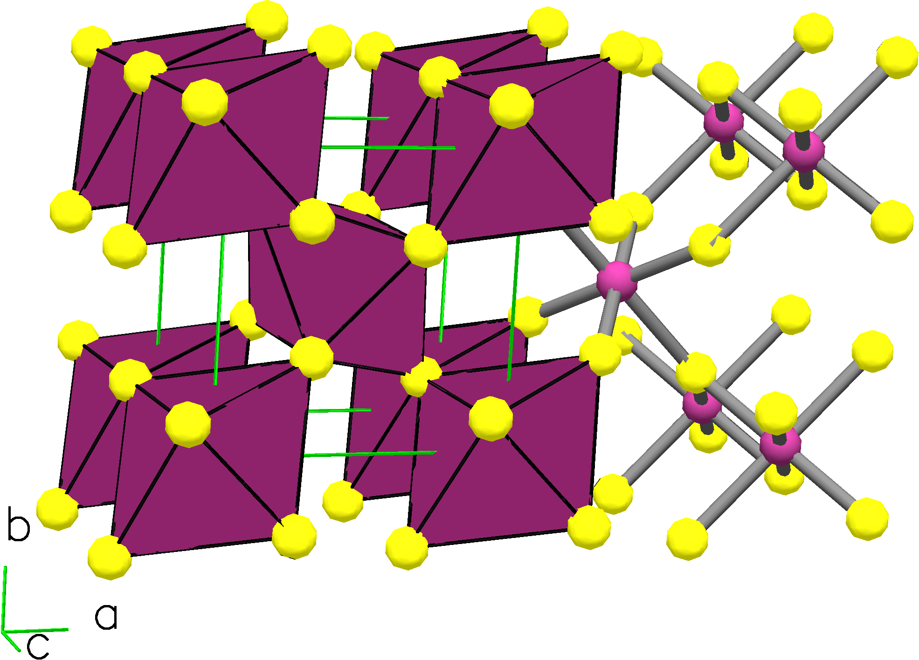
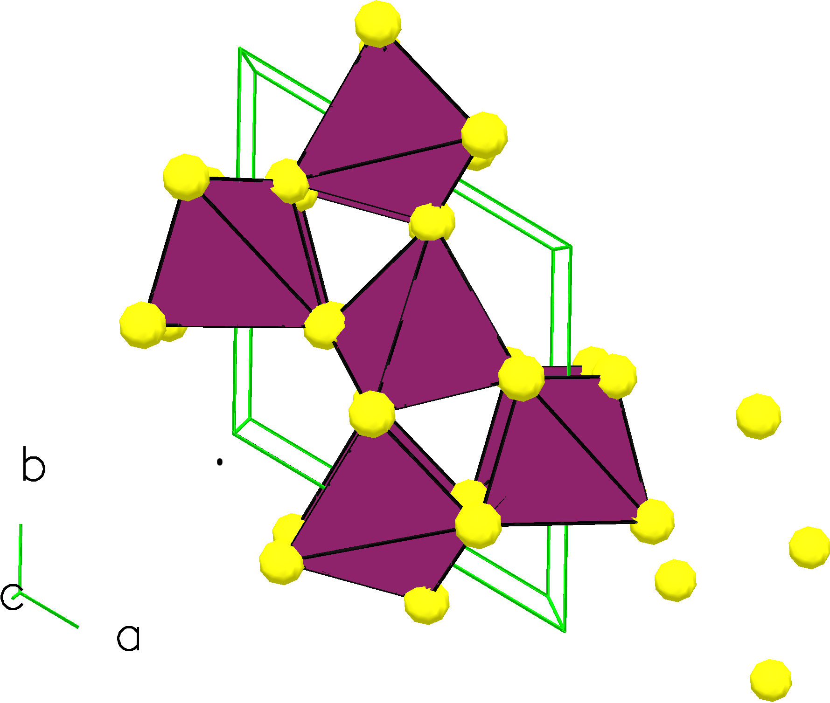
Quartz and Stishovite
Stishovite (rutile) structure
Dense
octahedrally coordinated Silicon
Quartz structure
Open structure
tetrahedrally coordinated Silicon

Slide 6
QMC results CASINO
(at DFT WC minimum)
 | Quartz (H) | Stishovite (H) | ΔE (eV/fu)
Exp. |  |  | 0.5
LDA |  |  | -0.05
PBE |  |  | 0.5
WC | -35.7466 | -35.7397 | 0.2
DMC MPC stish 3x3x3 qz 2x2x2 No finite size corrections | -35.8071 | -35.7912 | 0.43
DMC MPC stish 3x3x3 qz 2x2x2 with all corrections | -35.8038 | -35.7874 | 0.45
Blueice, NCAR (BTS grant); Abe NCSA; Perovskite, CIW

Slide 7
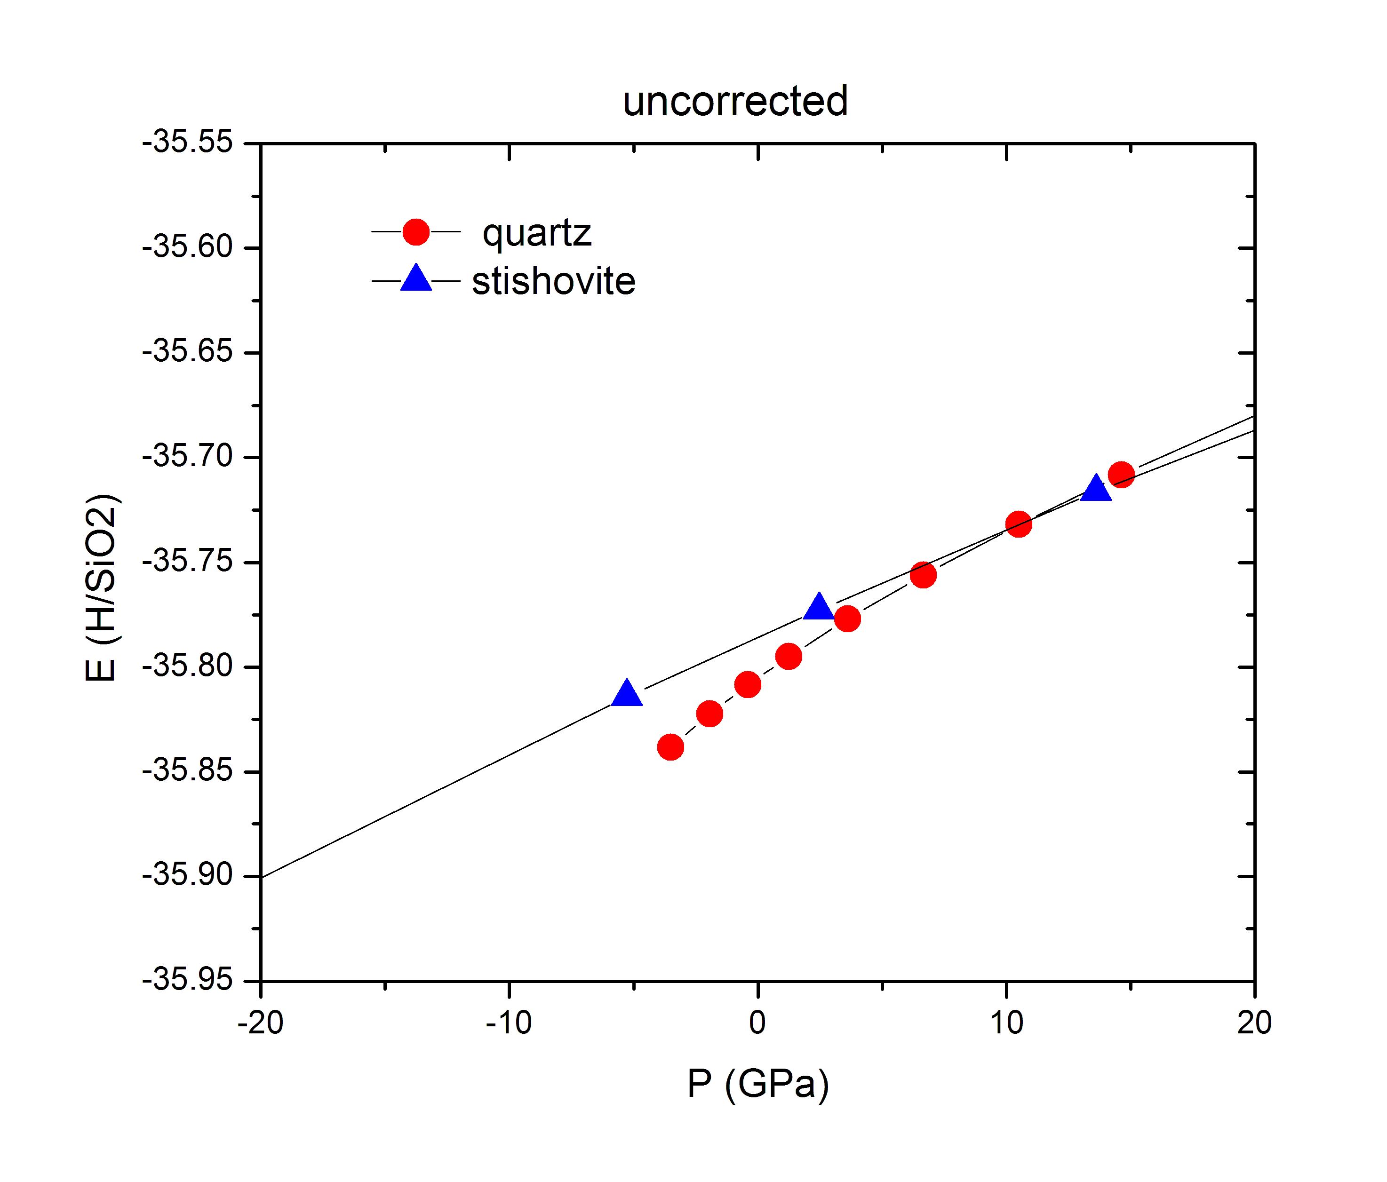
Quartz to stishovite transition
 | qz | st
V₀ (au) | 247 | 156
V₀ (exp) | 254 | 157
K₀ (GPa) | 39 | 309
K₀ (exp) | 38 | 313

Slide 8
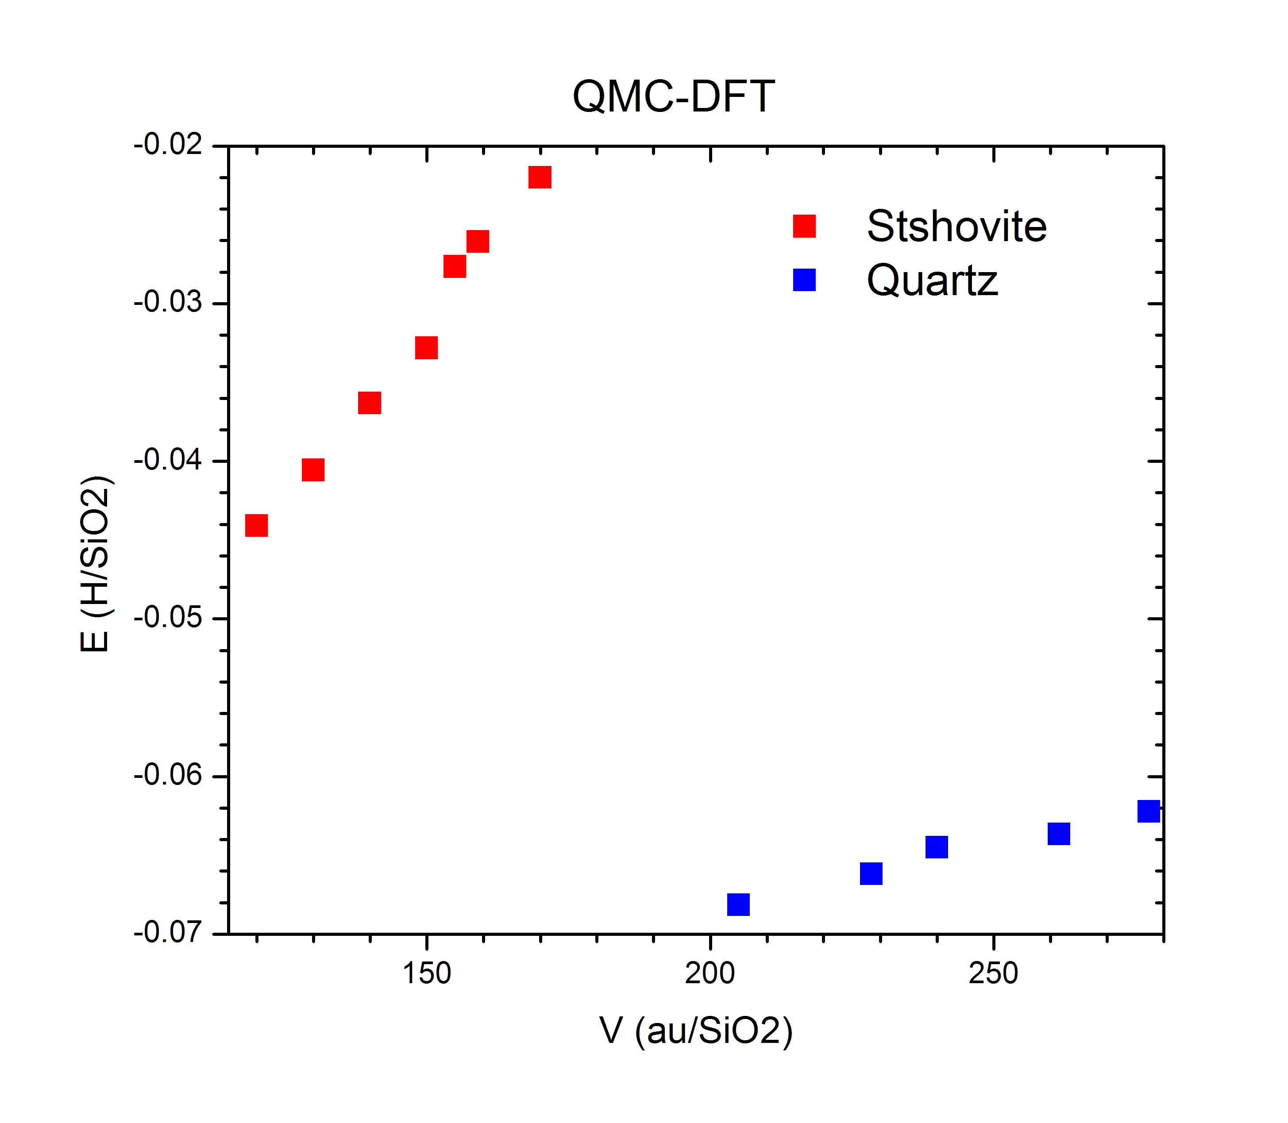
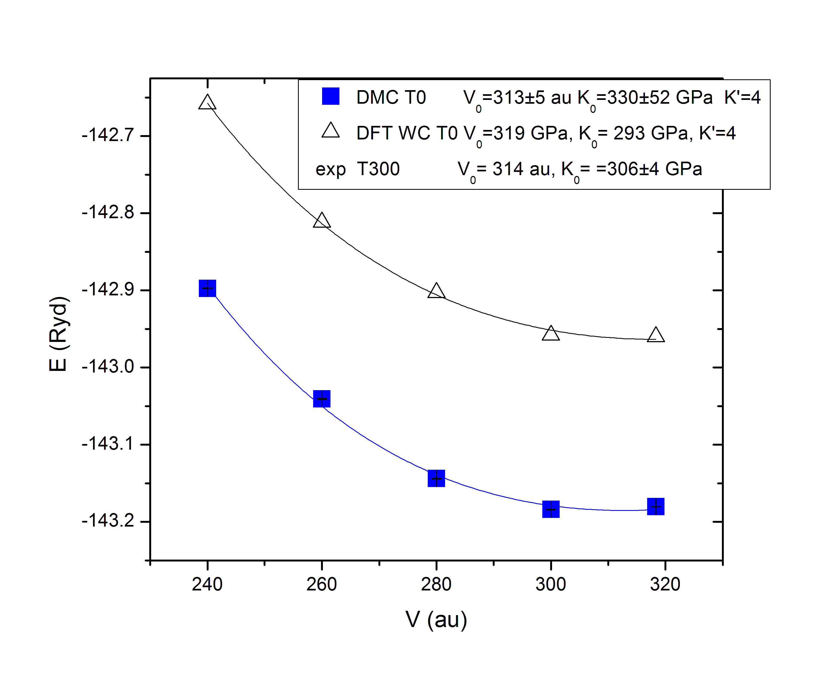
Comparison of QMC and DFT (WC xc)
 | stishovite | quartz
E₀ eV/SiO₂ | -0.77 | -1.76
P GPa | -4.6 | -8.0
Shifts in energy and pressure from DFT (WC) to QMC (QMC-DFT)

Slide 9
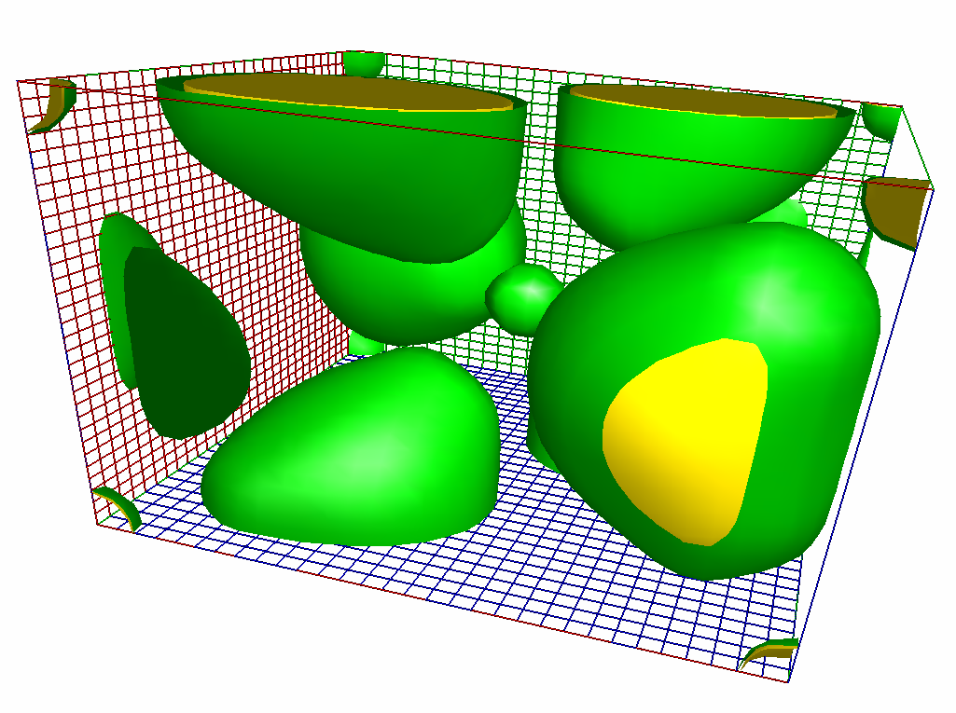
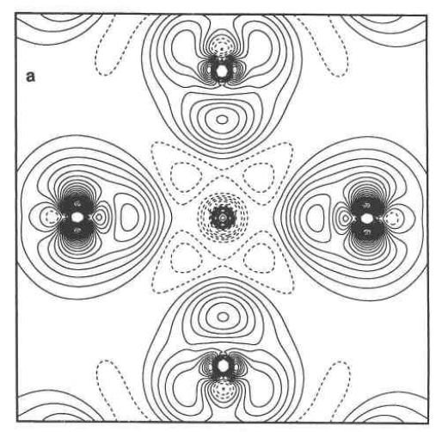
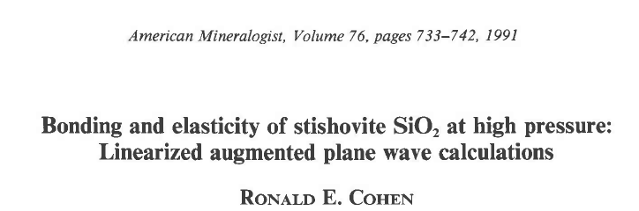
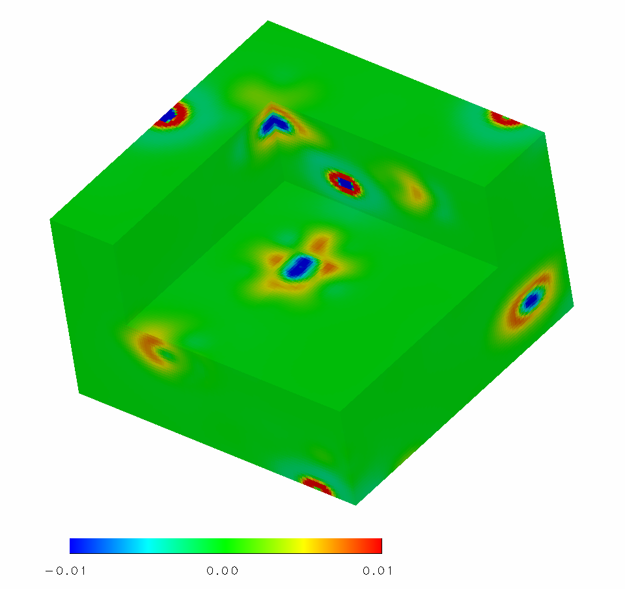
Silica
stishovite valence density
Simple close shelled electronic structure, yet problems with DFT
difference in GGA and LDA valence density
Contour interval 0.007 e/au³
 | LDA | PBE* | WC** | Exp.
ΔE (eV) | -0.05 | 0.5 | 0.2 | 0.5
P_{tr} | <0 | 6.2 | 2.6 | 7.5
V_{qz} | 244 | 266 | 261 | 254
K_{qz} | 35 | 44 | 29 | 38
V_{st} | 155 | 163 | 159 | 157
K_{st} | 303 | 257 | 330 | 313
±0.01 e/au³
*Zupan, Blaha, Schwarz, and Perdew, Phys. Rev. B 58, 11266 (1998).
Wu and R. E. Cohen, Phys. Rev. B 73, 235116 (2006).

Slide 10
Elasticity—c11-c12 stishovite
K.Driver, Ohio State

Slide 11
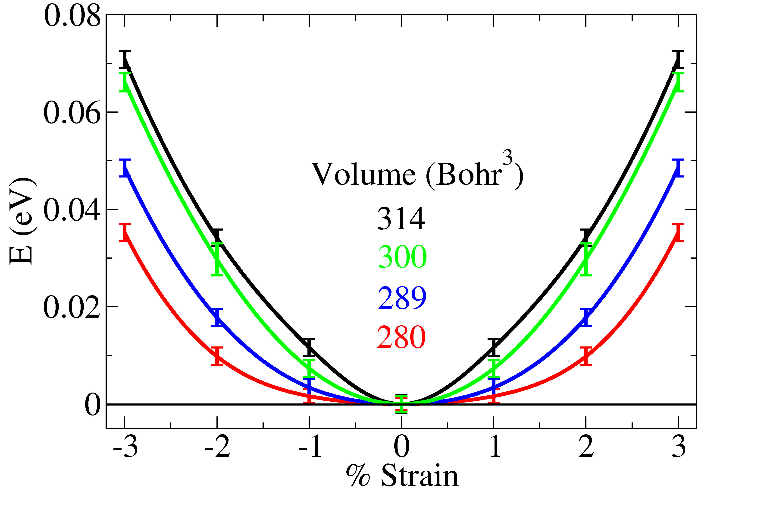
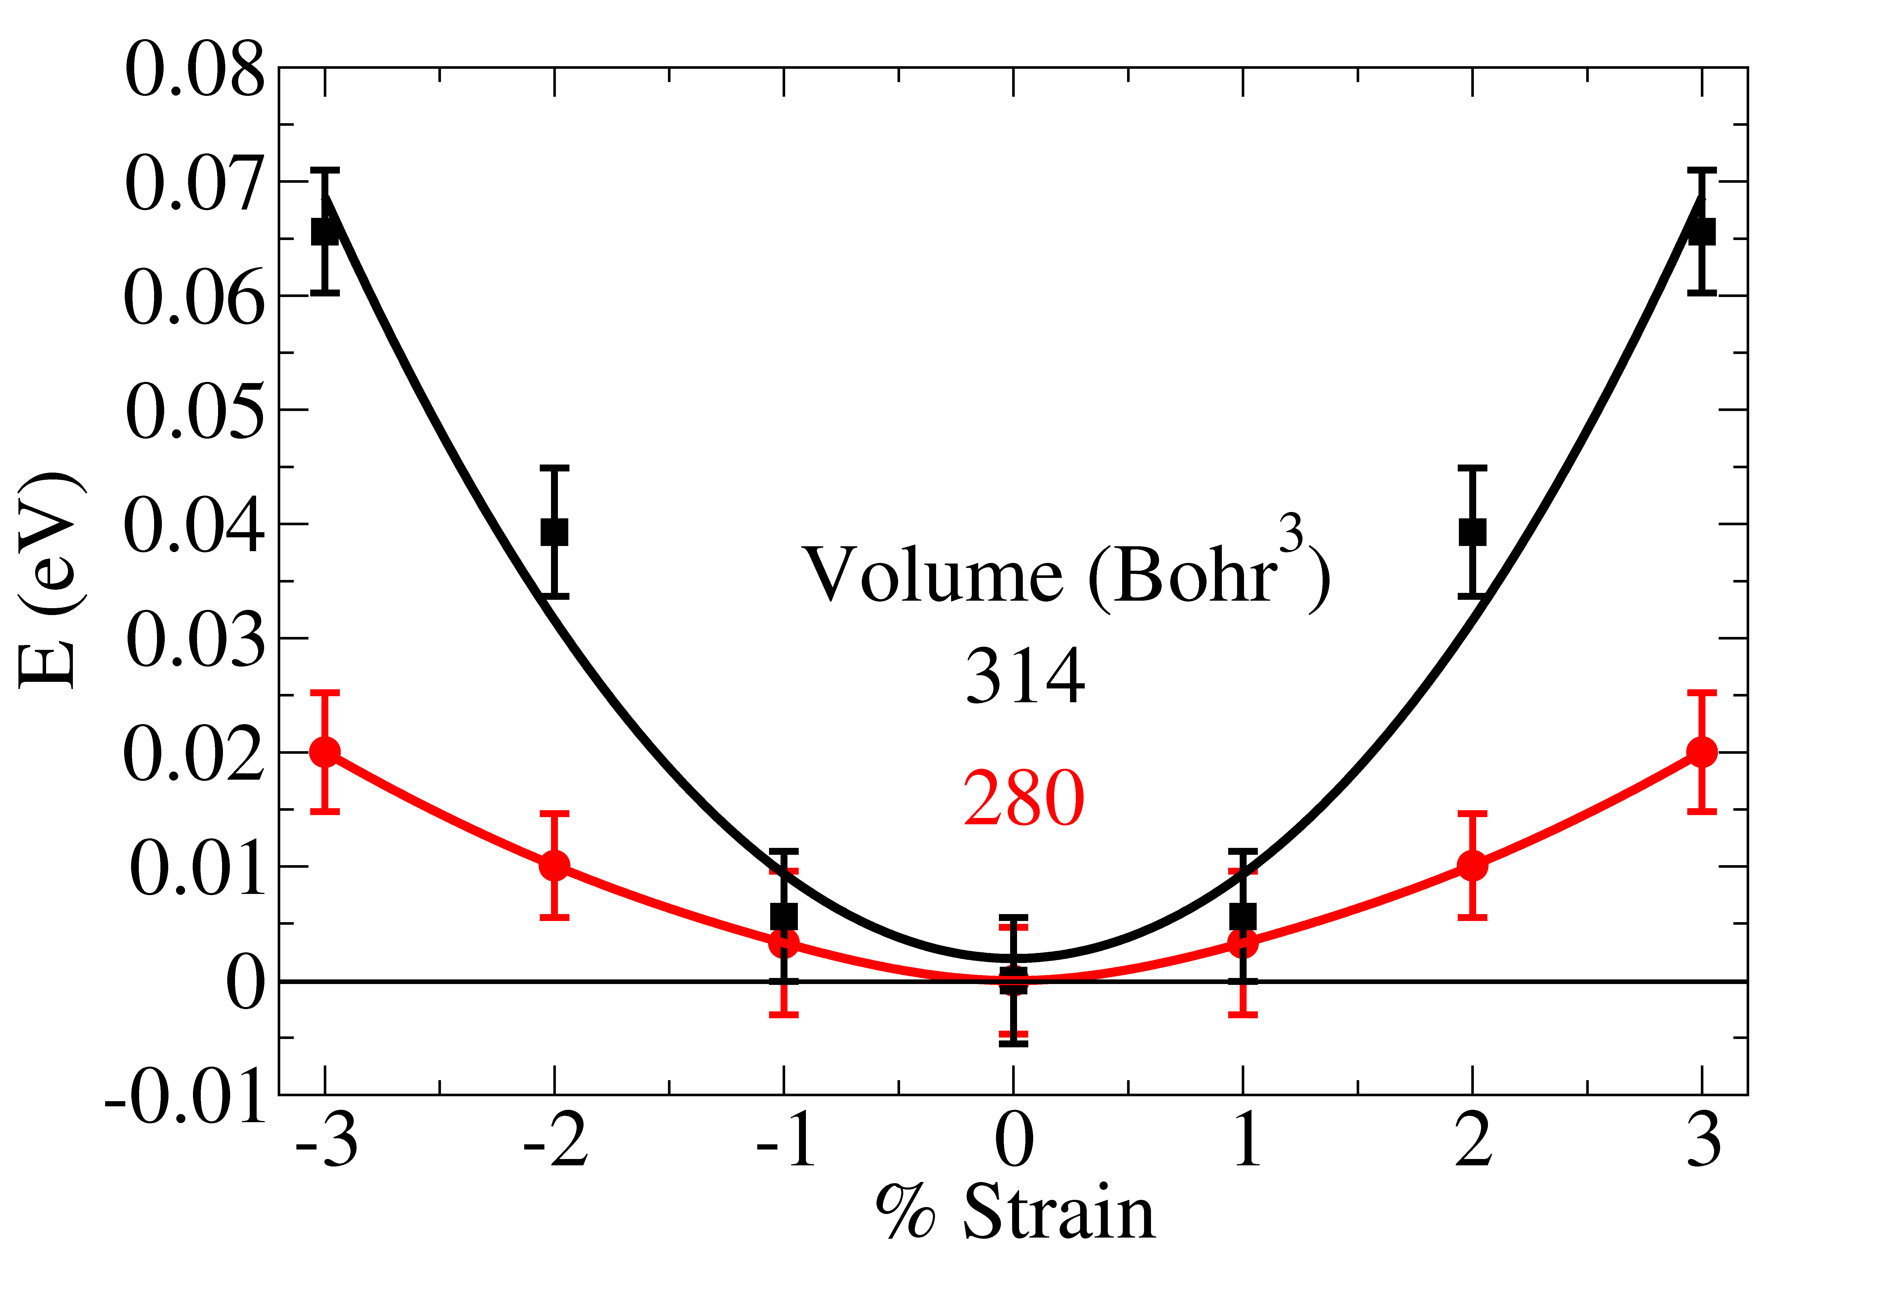
Elasticity—c11-c12 stishovite
Driver, K. P., Cohen, R. E., Wu, Z., Militzer, B., R√≠Os, P. L. P., Towler, M. D., Needs, R. J. & Wilkins, J. W. Quantum Monte Carlo computations of phase stability, equations of state, and elasticity of high-pressure silica. Proceedings of the National Academy of Sciences 107, 9519-9524 (2010).
over 2 million CPU hours on NESRC Cray XT4 TM “Franklin” system contains nearly 20,000 processor cores, now retired
500,000 CPU hours
1,300,000 CPU hours

Slide 12
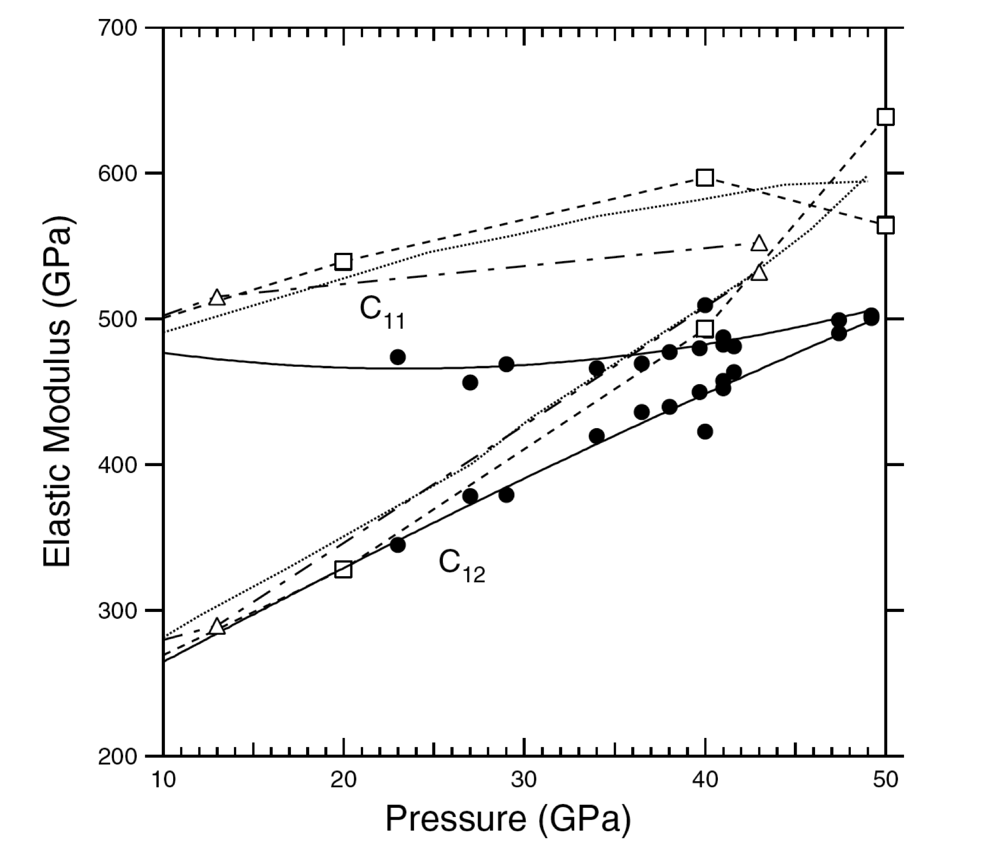
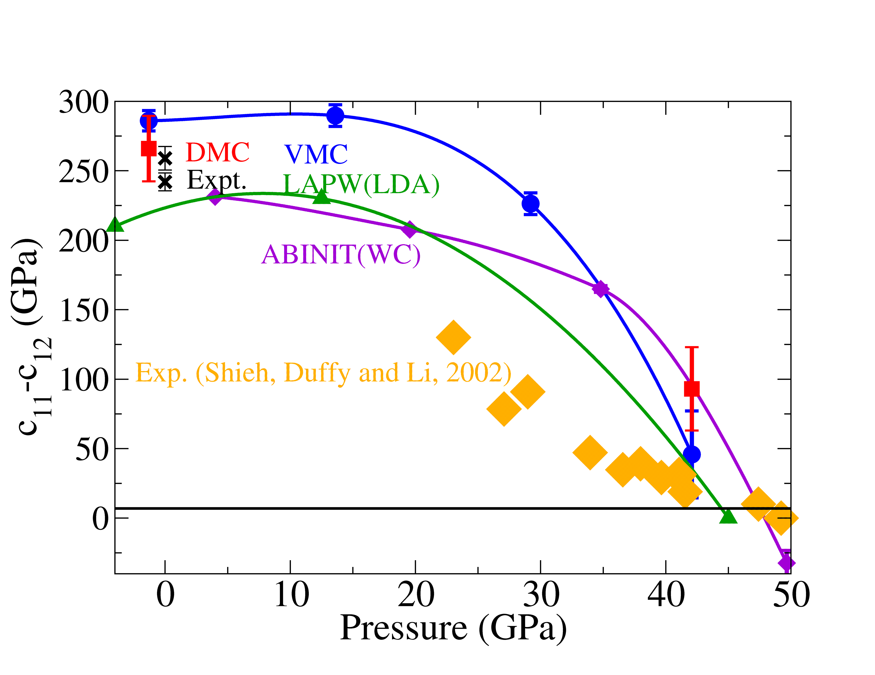
Elasticity—c11-c12 stishovite
Driver, K. P., Cohen, R. E., Wu, Z., Militzer, B., R√≠Os, P. L. P., Towler, M. D., Needs, R. J. & Wilkins, J. W. Quantum Monte Carlo computations of phase stability, equations of state, and elasticity of high-pressure silica. Proceedings of the National Academy of Sciences 107, 9519-9524, doi:10.1073/pnas.0912130107 (2010).
Lattice strain technique in DAC
Shieh, Duffy, and Li, 2002

Slide 13
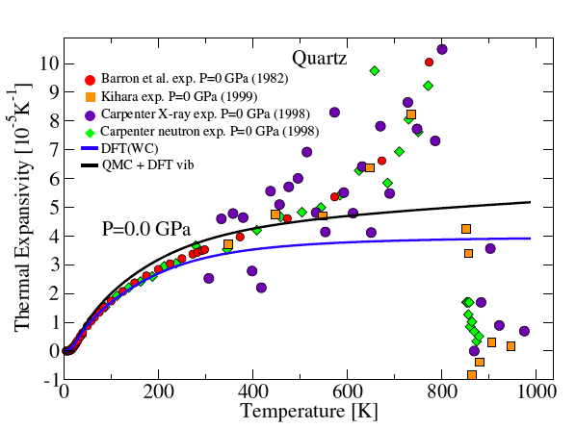
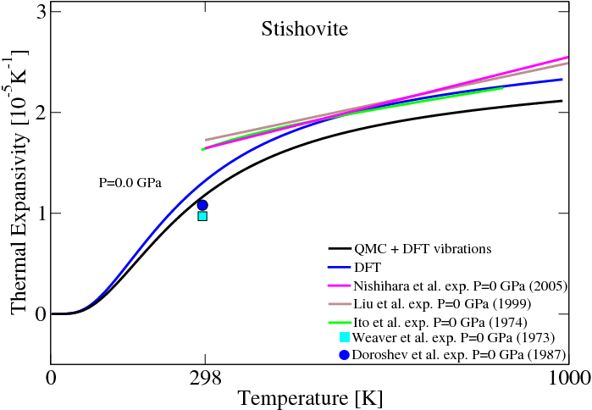
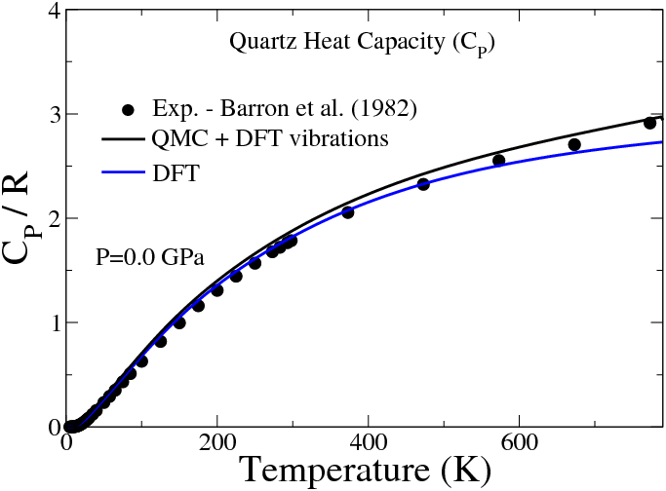
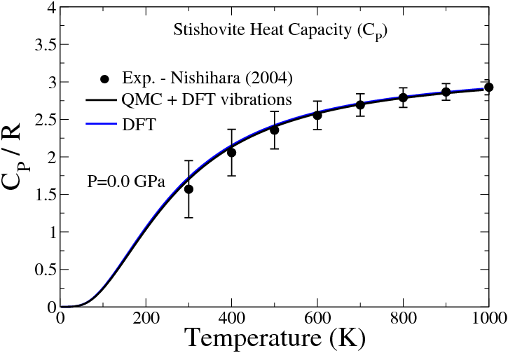
Thermal Equation of State (T=0 DMC+DFPT)

Slide 14
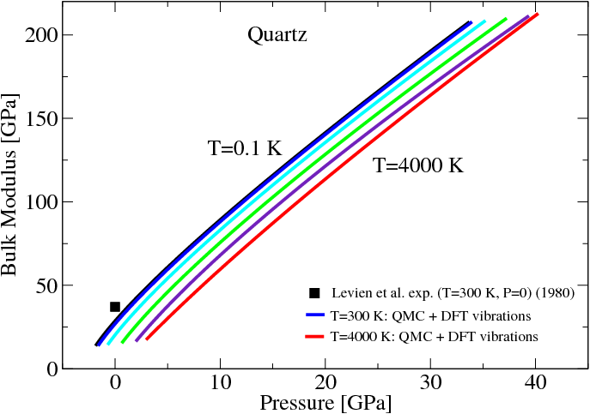
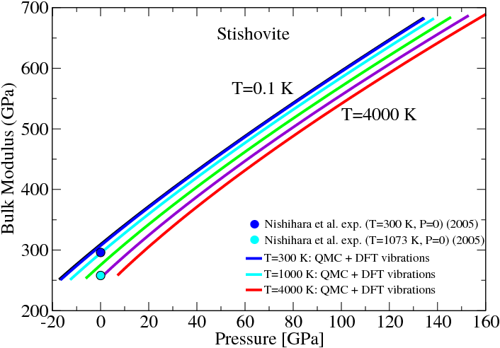
Thermal Equation of State (T=0 DMC+DFPT)
Driver, K. P., Cohen, R. E., Wu, Z., Militzer, B., R√≠Os, P. L. P., Towler, M. D., Needs, R. J. & Wilkins, J. W. Quantum Monte Carlo computations of phase stability, equations of state, and elasticity of high-pressure silica. Proceedings of the National Academy of Sciences 107, 9519-9524 (2010).

Slide 15
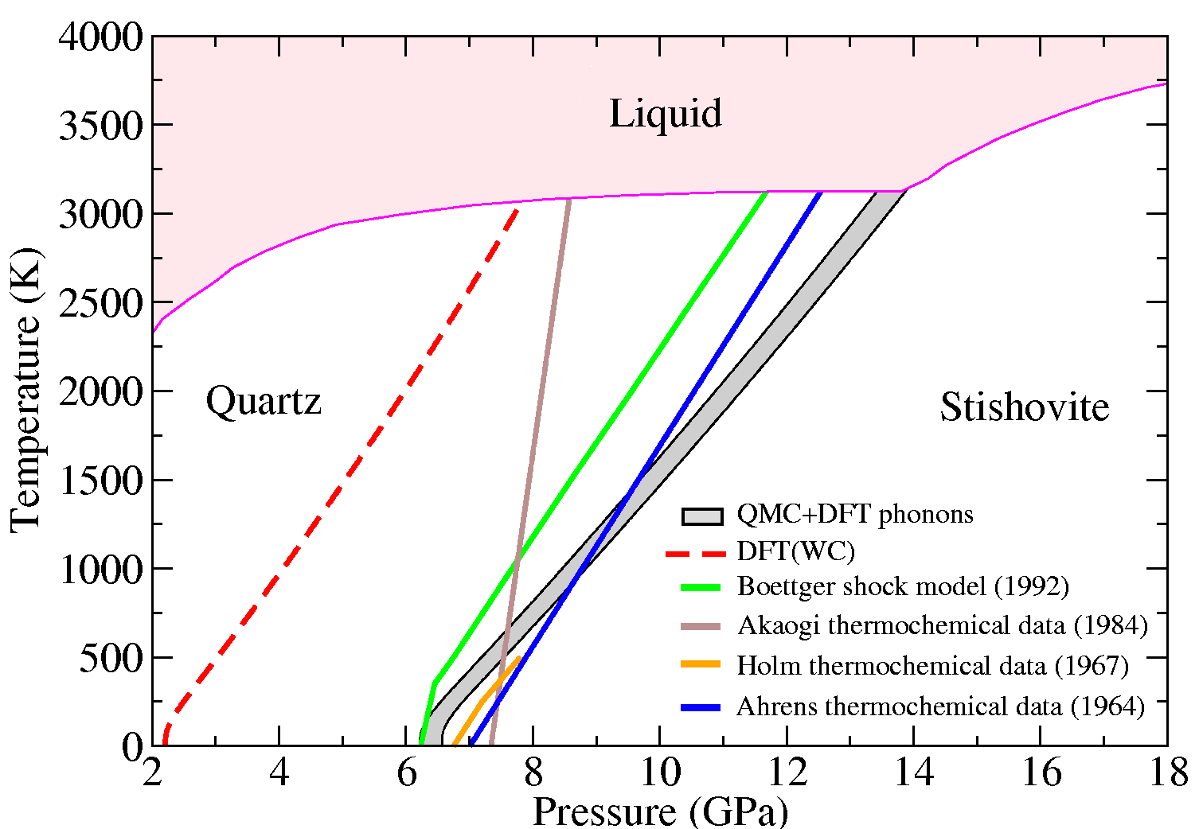
Quartz-Stishovite Phase Boundary

Slide 16
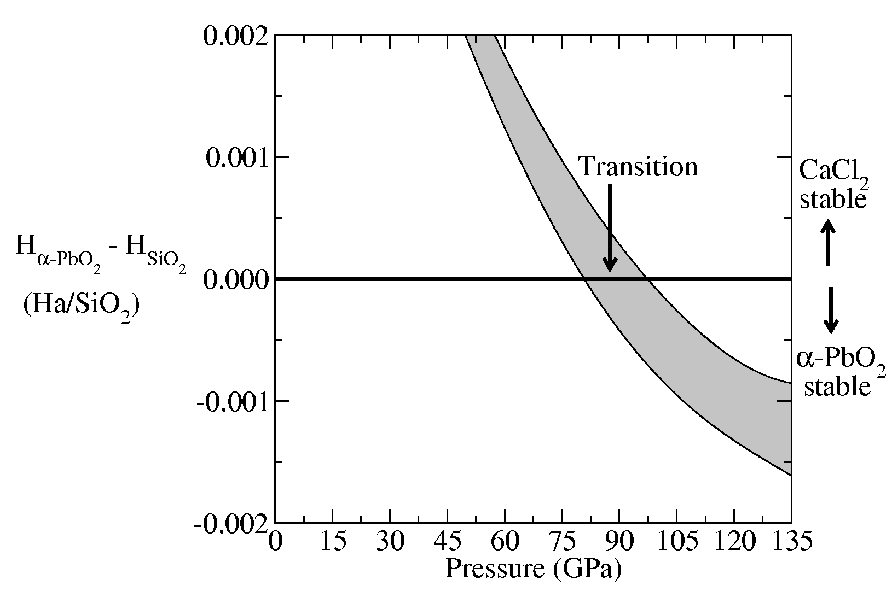
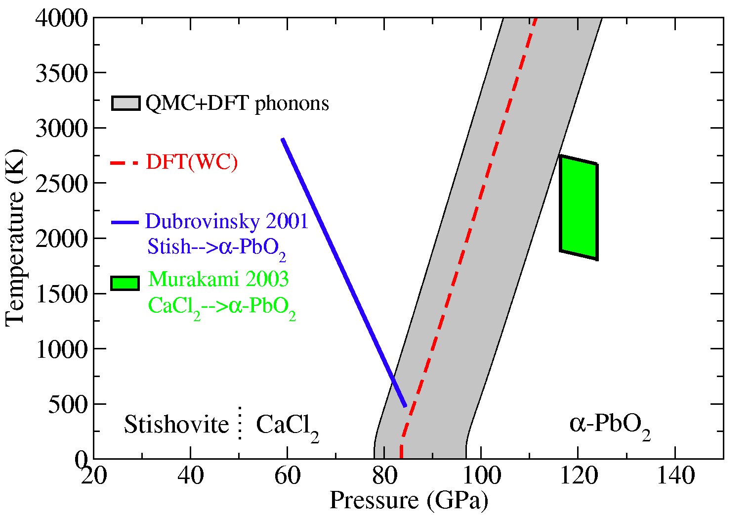
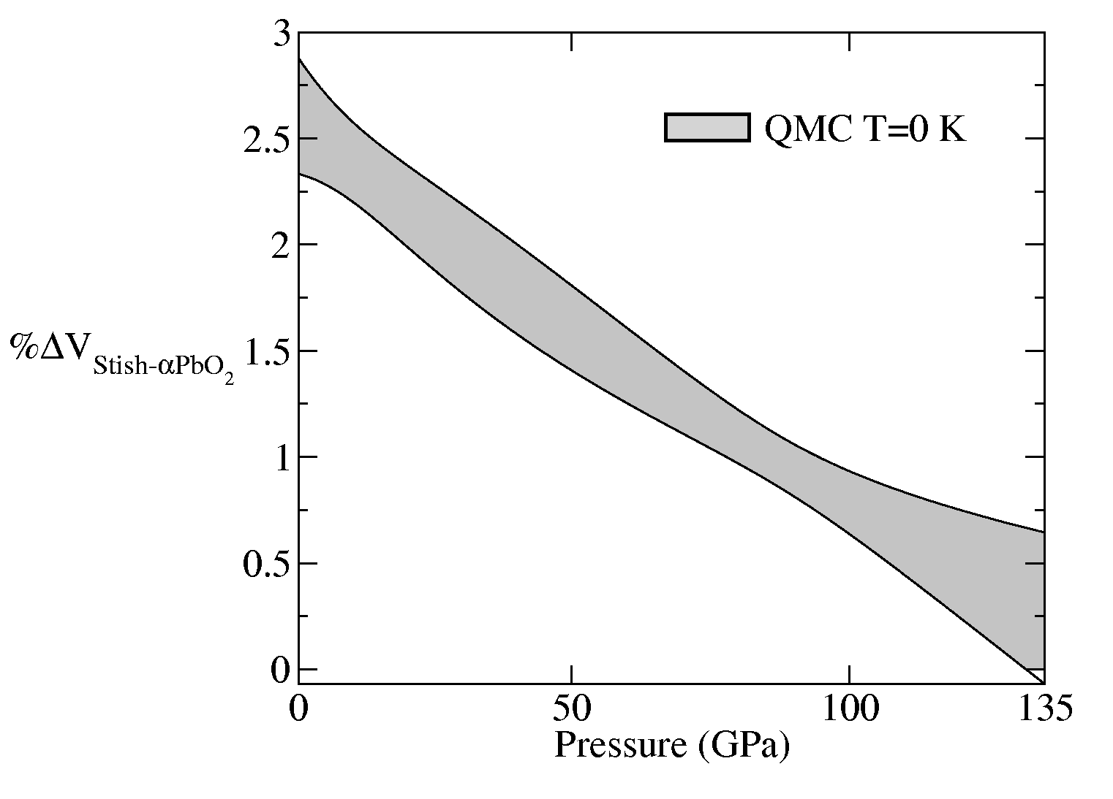
SiO₂ CaCl2-structure → α-PbO2 structure
(bohr³/mol)
Driver, K. P., Cohen, R. E., Wu, Z., Militzer, B., R√≠Os, P. L. P., Towler, M. D., Needs, R. J. & Wilkins, J. W. Quantum Monte Carlo computations of phase stability, equations of state, and elasticity of high-pressure silica. Proceedings of the National Academy of Sciences 107, 9519-9524 (2010).

Slide 17
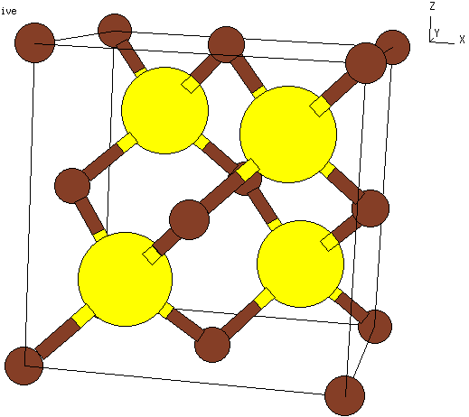
cBN as a pressure standard
Cubic boron nitride is an ideal pressure standard.
  Stable over wide
pressure and temperature range
  Single Raman mode for calibration
  Single lattice parameter

Slide 18
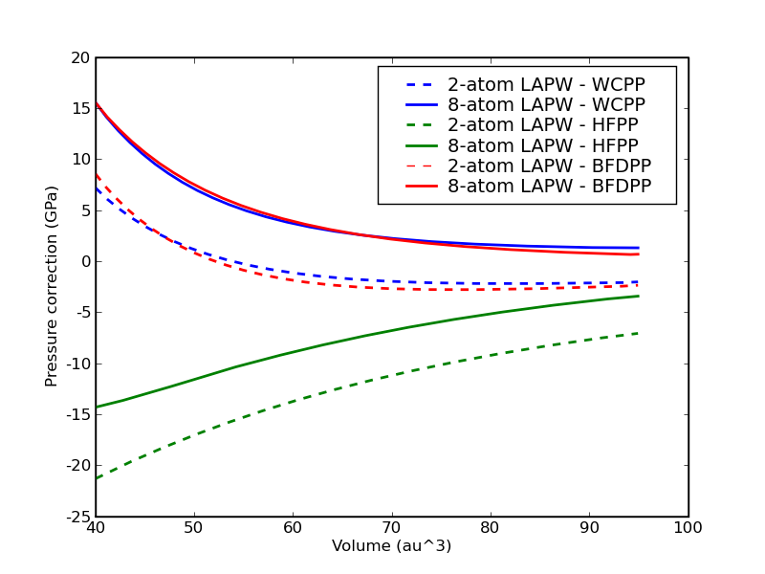
Pseudopotentials are remaining source of error
Cannot afford to do a large
supercell with all-electron
Therefore, compute pseudo-
potential corrections in small
supercells and extrapolate
to bulk limit
Did comparison for 3 PPs:
  Wu-Cohen GGA
  Trail-Needs Hartree-Fock
  Burkatzki et al Hartree-Fock
Computed pressure corrections
by taking (LAPW EOS – PP EOS)‏
Two supercells: 2-atom and 8-atom

Slide 19
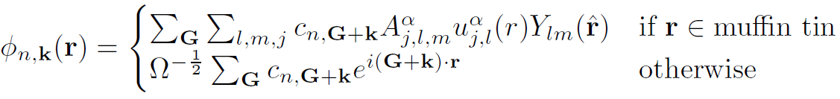
All-electron QMC for solids
Current QMC calculations on solids use pseudopotentials (PPs) from Hartree-Fock or DFT
When different PPs give different results, how do we know which to use?
In DFT, decide based on agreement with all-electron calculation
We would like to do the same in QMC. Has only been done for hydrogen and helium.
LAPW is generally gold standard for DFT.
Use orbitals from LAPW calculation in QMC simulation.
Requires efficient evaluation methods and careful numerics
Use atomic-like representation near nuclei, plane-wave or B-splines in interstitial region:

Slide 20
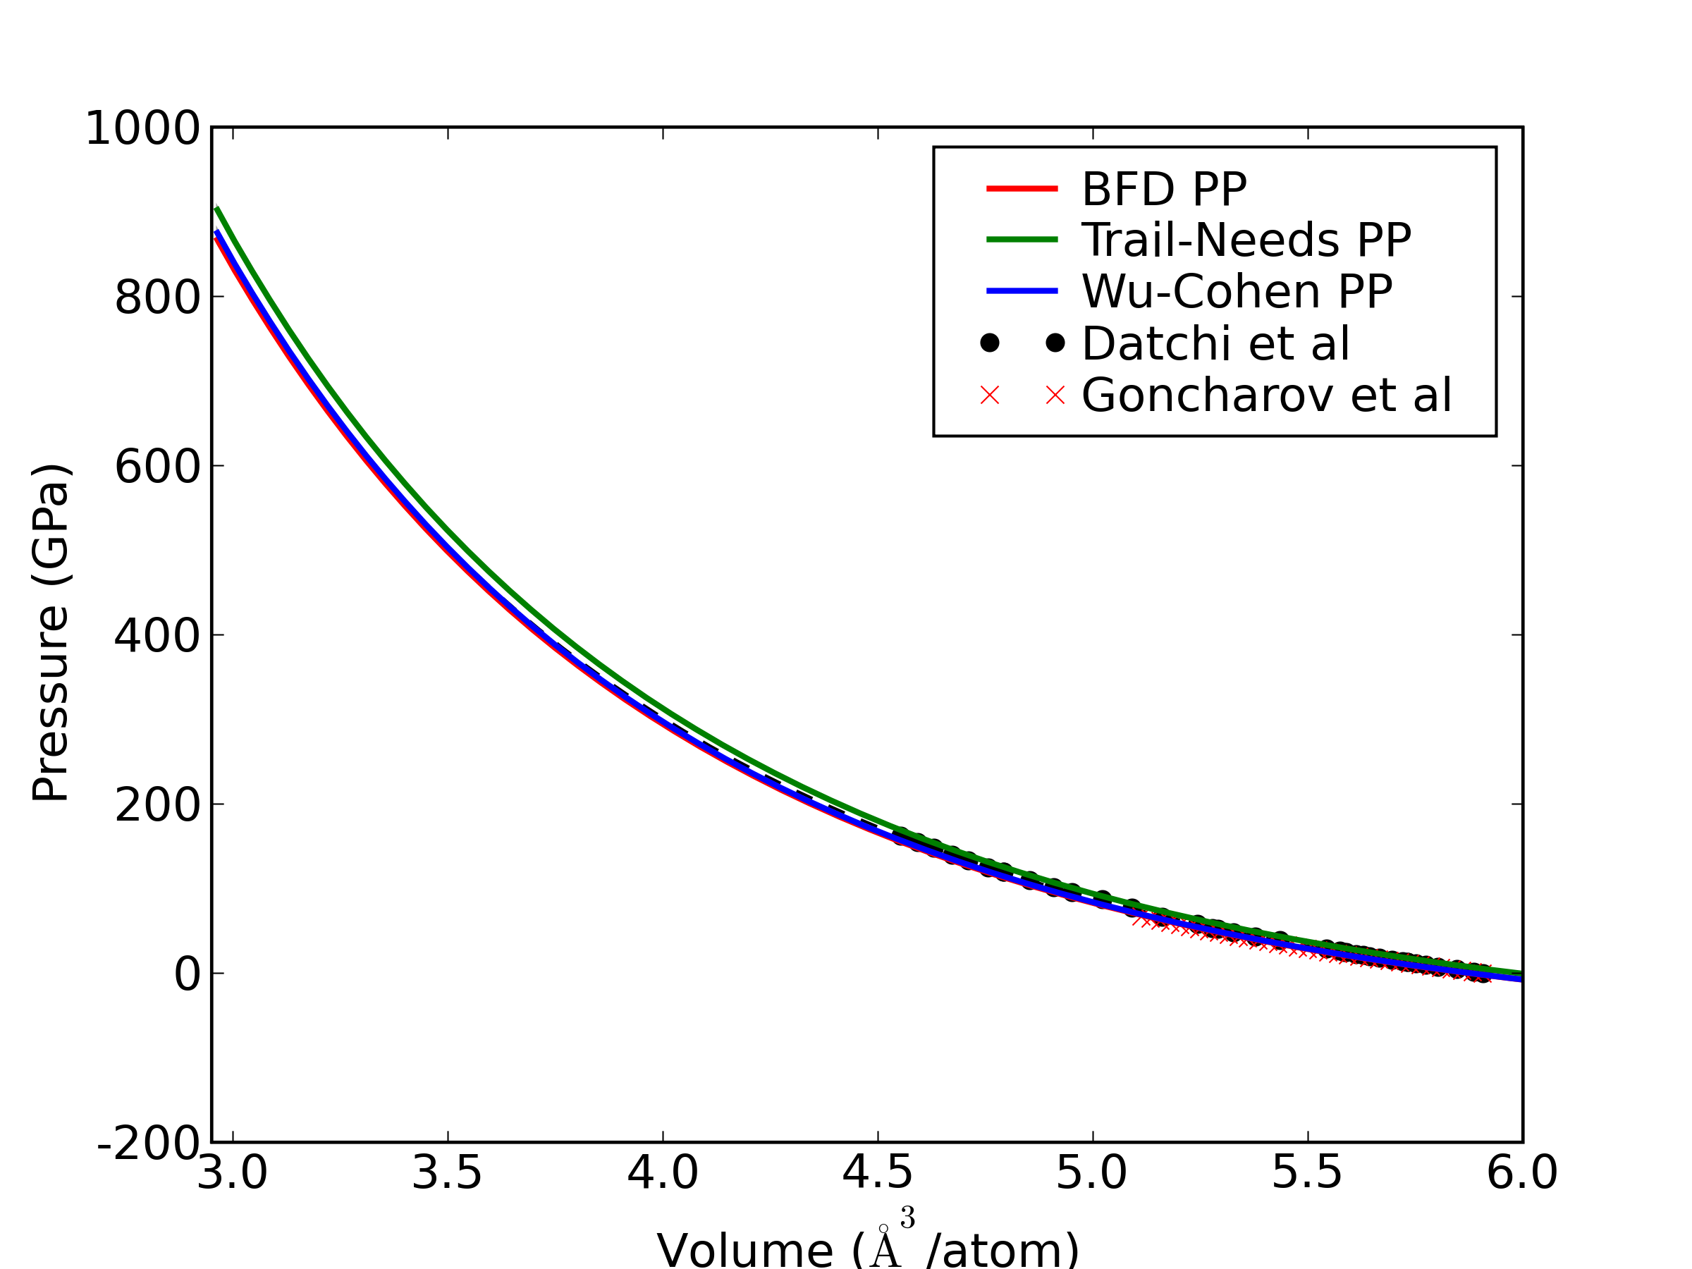
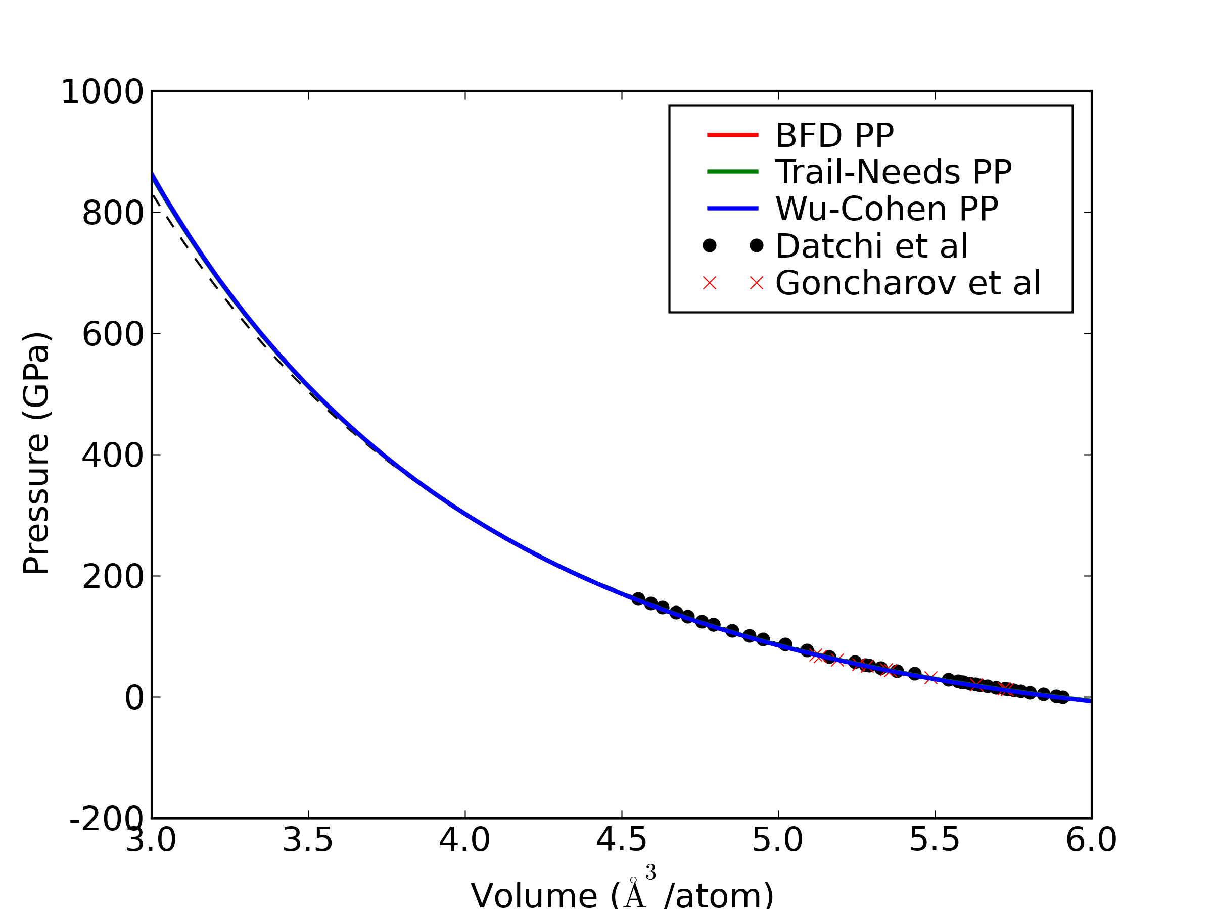
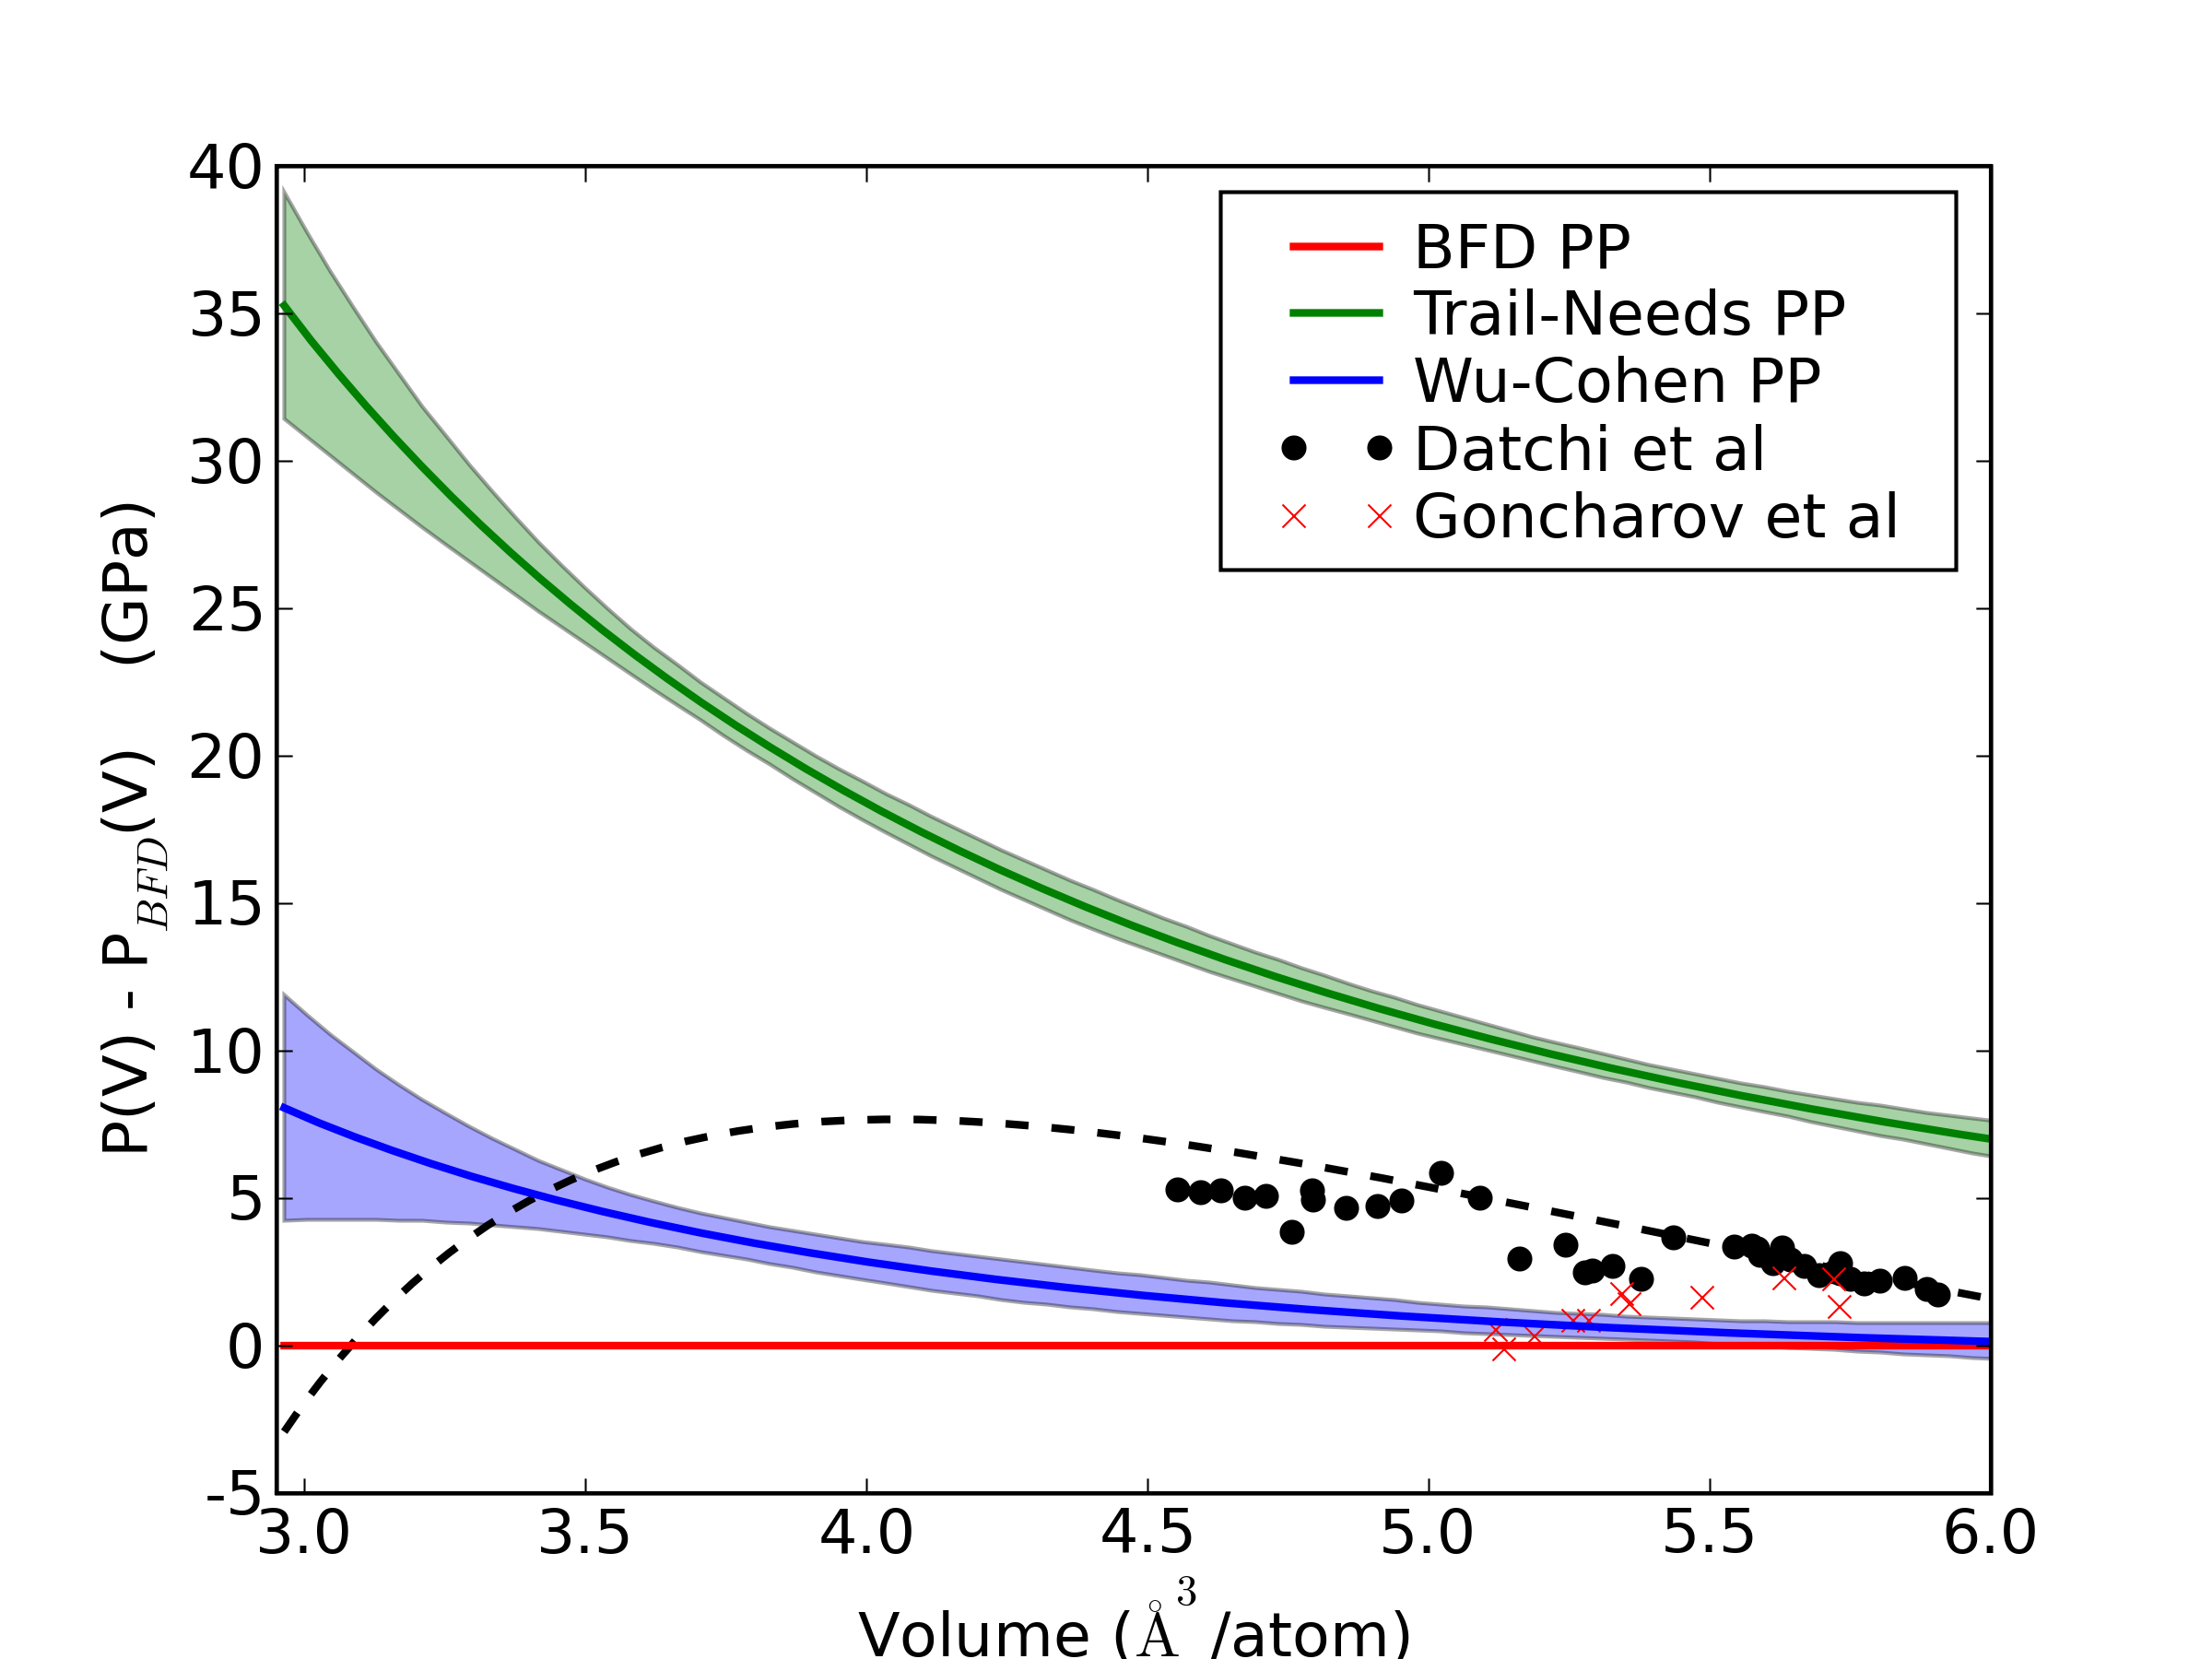
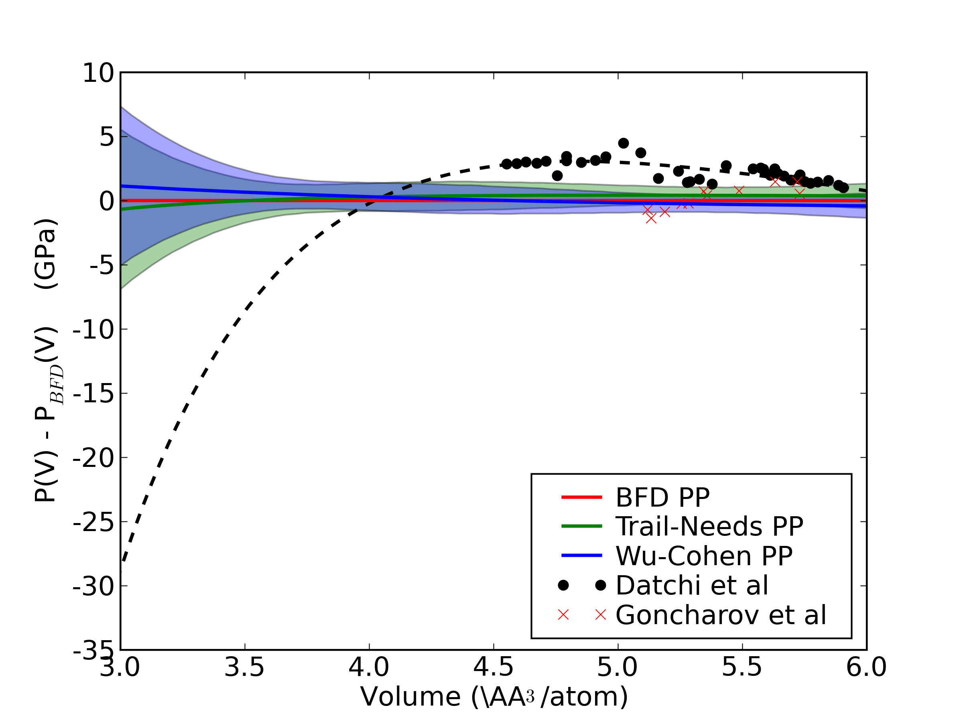
cBN equation of state
uncorrected
corrected
64 atom supercell, qmcPACK

Slide 21
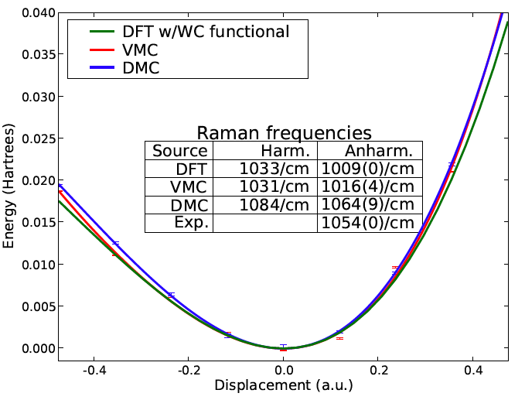
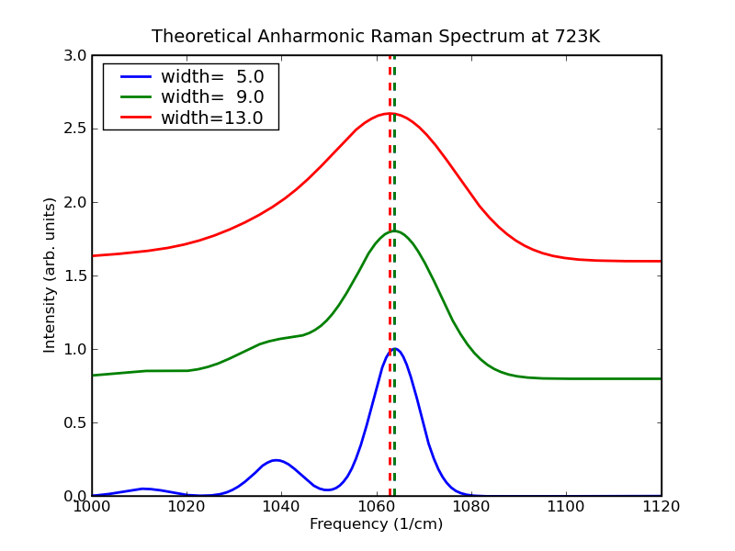
cBN Raman Frequencies
Within harmonic approx. DFT frequency is reasonable
But, cBN Raman mode is quite anharmonic
With anharmonic corrections, DFT frequencies are not so good.
Compute energy vs. displacement with DMC and do 4th-order fit. Solve 1D Schrodinger eq. to get frequency
Anharmonic DMC frequency is correct to within statistical error

Slide 22
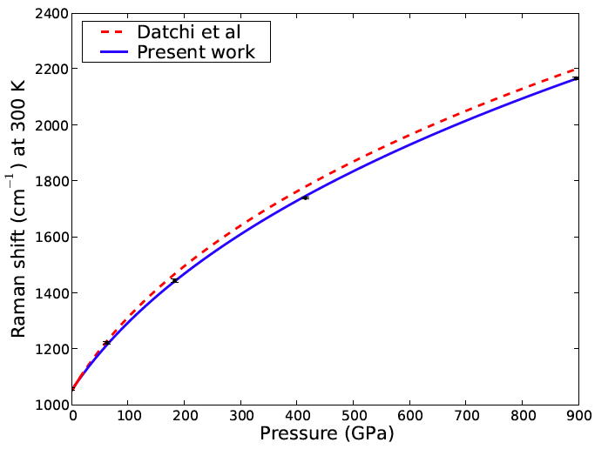

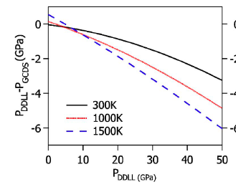
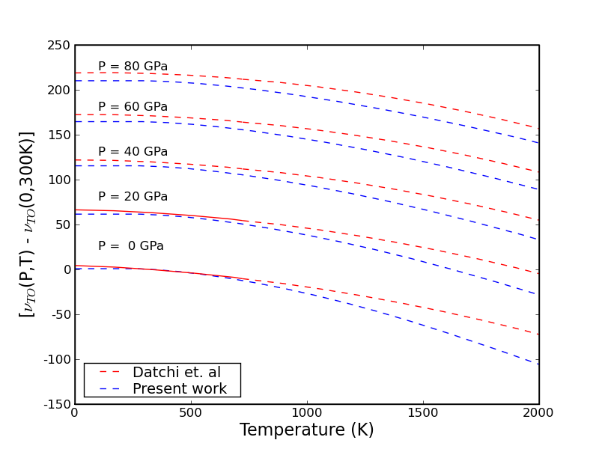
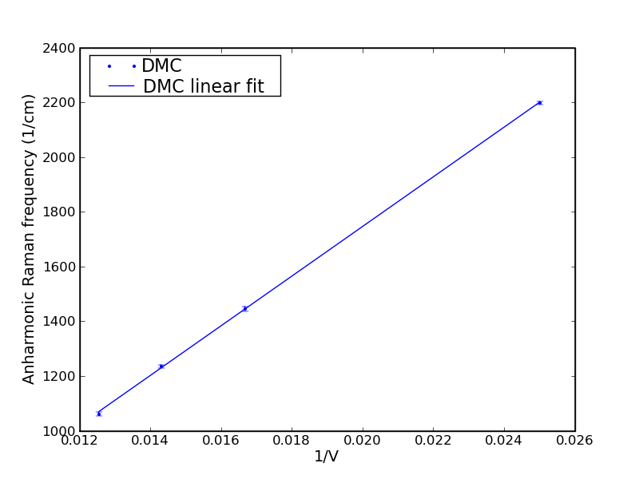

cBN Raman Frequencies
Raman frequencies are linear in 1/V
When combined with EOS, data can be used to directly measure pressure from the Raman frequency
There is some intrinsic T-dependent shift due to anharmonicity
Extrapolated
Measured
See also

Slide 23
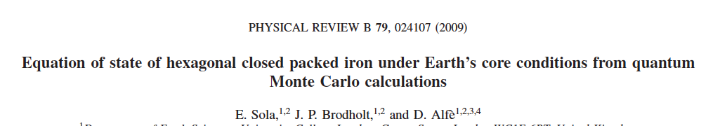
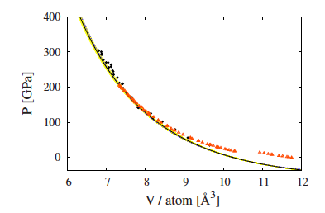
The calculated equation of state agrees closely with the experiments of Mao et al. and those of Dewaele et al.. It also agrees with the DFT data of Söderlind et al. and Alfè et al., and therefore, reinforces those previous calculations.

Slide 24
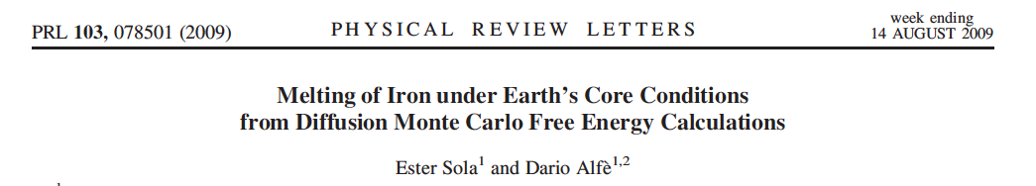
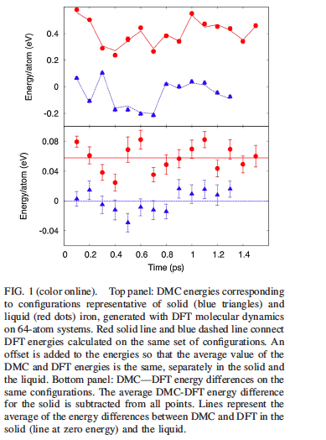
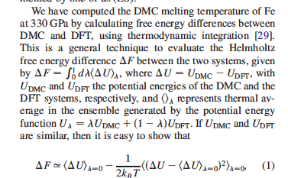
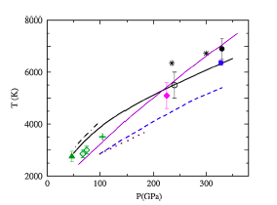
DMC

Slide 25
Summary
There are only a few examples of applications of QMC to geophysics and high pressure problems, but they are all very promising.
DFT is also fairly successful for closed shell systems.
The field is wide open.

