Slide 1
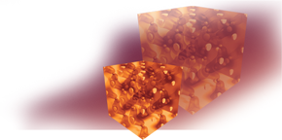
2012 Summer School on Computational Materials Science
Quantum Monte Carlo: Theory and Fundamentals
July 23–-27, 2012 • University of Illinois at Urbana–Champaign
http://www.mcc.uiuc.edu/summerschool/2012/
Dynamical Mean Field Theory on FeO under pressure
Ronald Cohen
Geophysical Laboratory
Carnegie Institution of Washington
cohen@gl.ciw.edu
QMC Summer School 2012 UIUC

Slide 2
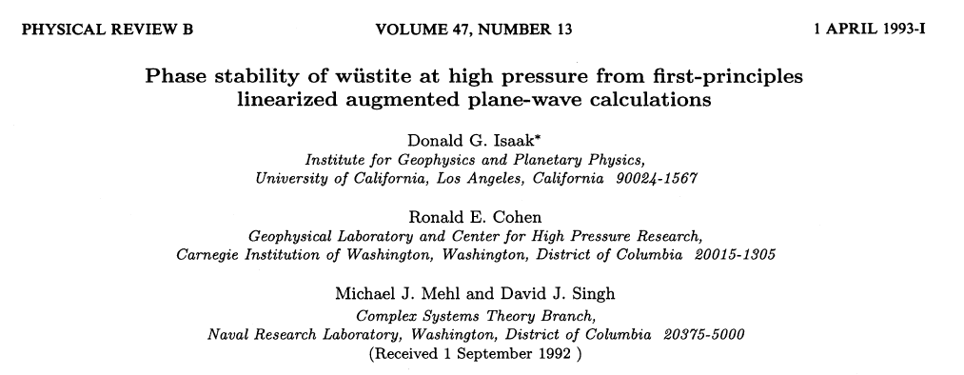
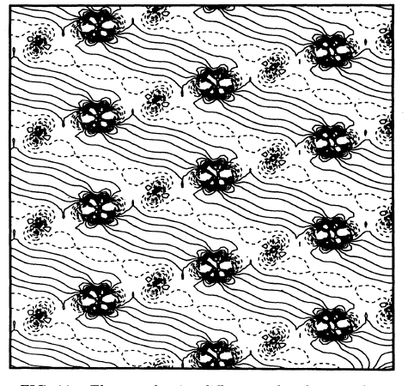
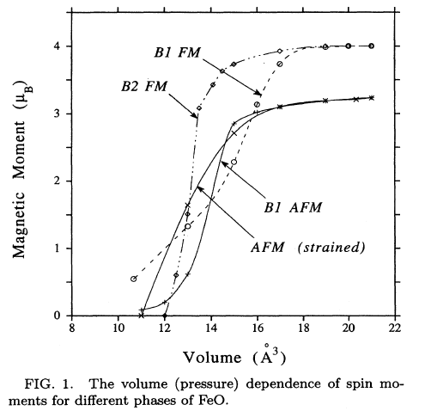
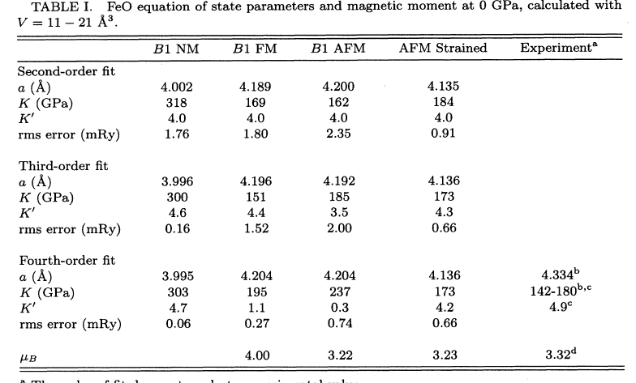

Slide 3
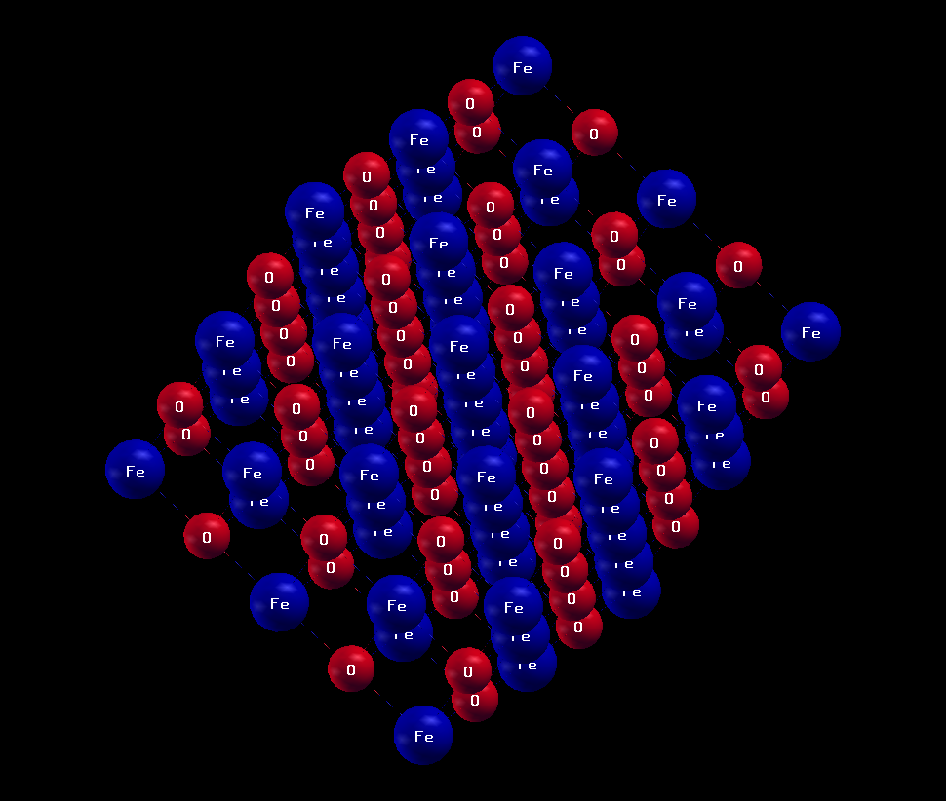
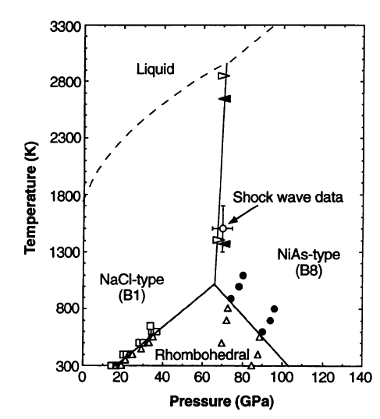
Background: FeO
At ambient pressure FeO is an
antiferromagnetic insulator with a
rock salt structure
Iron 3d states partially filled, but
localized
Borderline between charge transfer and Mott insulator
Difficult to make stoichiometric
FeO in the lab at low pressures (vacancies yield Fe1-xO where x ~ 0.07) but stoichiometric under pressure
Knittle and Jeanloz, JGR 1991
The phase diagram as of
1994 (Fei and Mao, Science,
266, 1678, 1994)

Slide 4
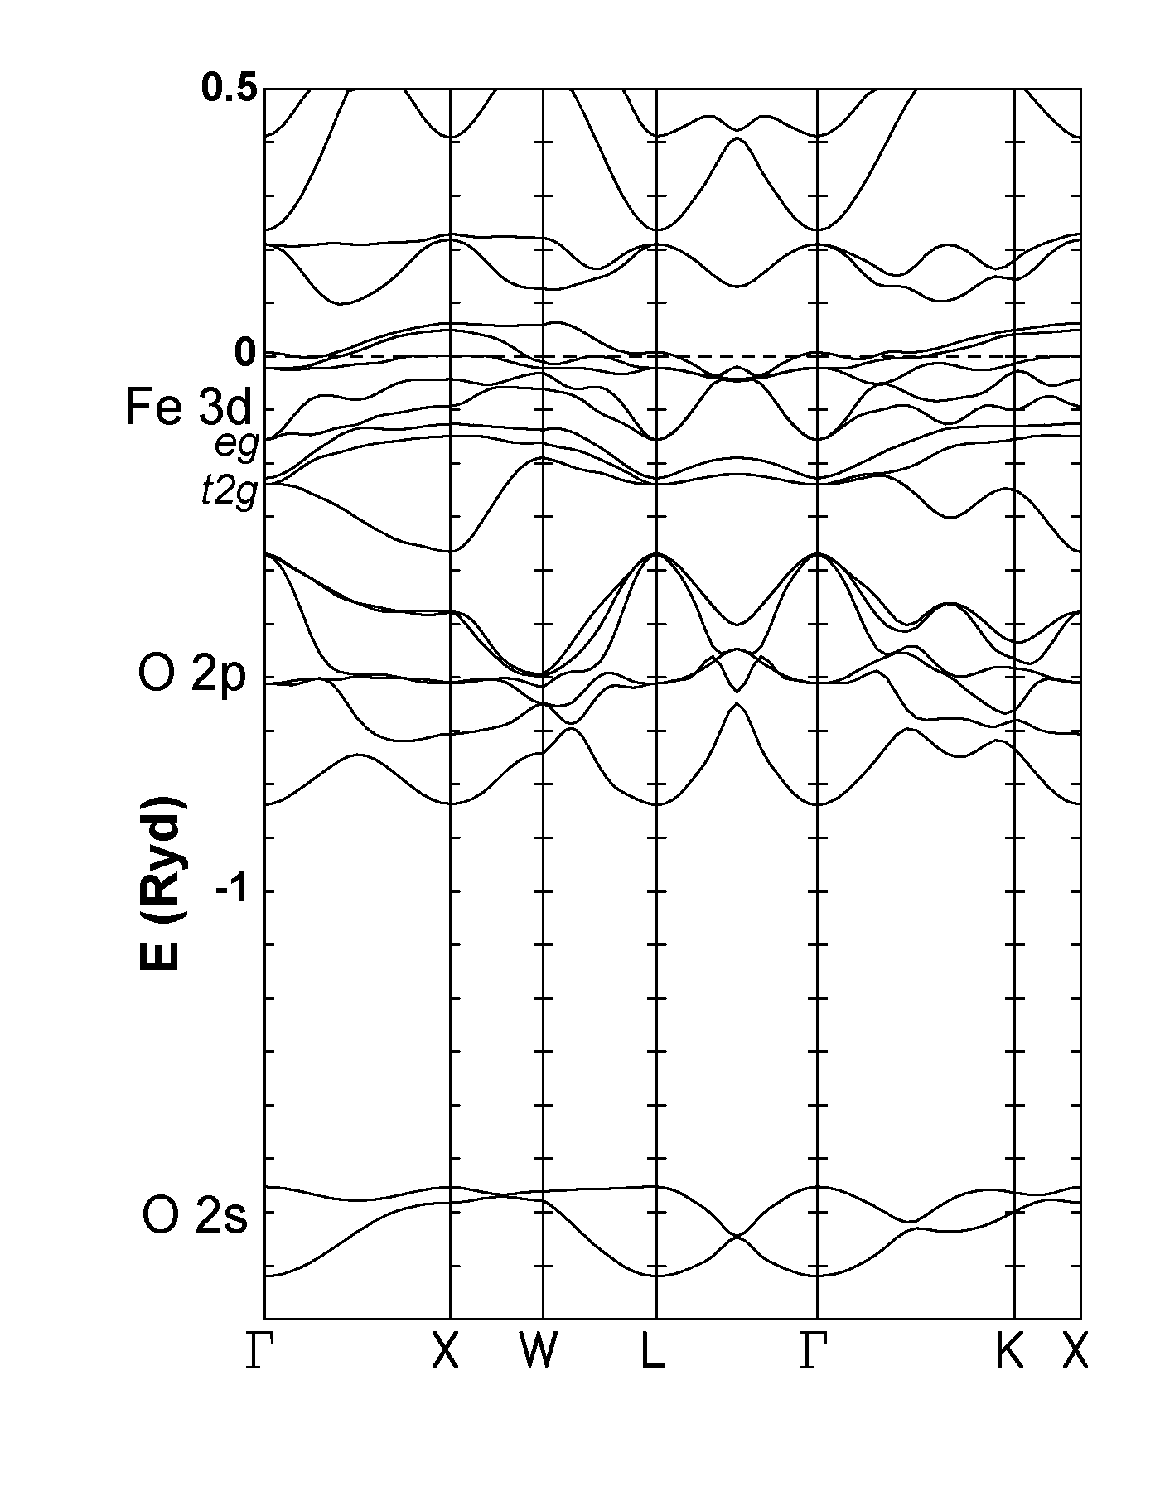
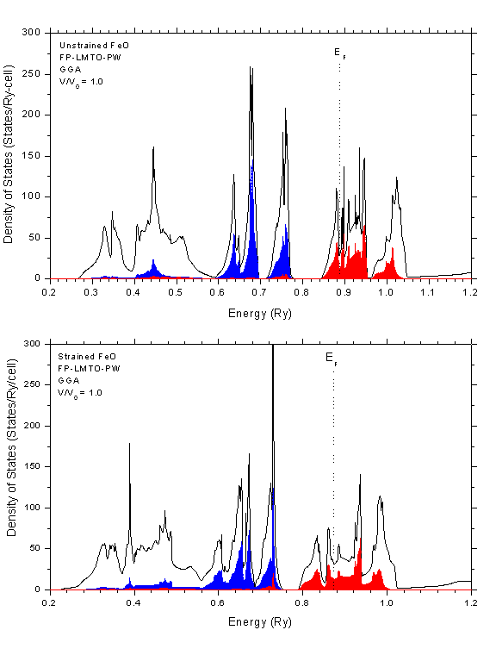
FeO wüstite is an insulator at ambient conditions
LDA/GGA etc. make it a metal
LDA+U does open a gap in AFM rhombohedral or lower symmetry FeO and predicts a metal insulator transition under pressure, but not a high-spin low-spin transition. (Gramsch, Cohen, and Savrasov, Am. Mineral., 88, 257 (2003).
LDA+U is a model, and how accurate it is unknown.
LDA+U cannot give a gap in paramagnetic FeO.
Cohen et al. (1998) High-Pressure Materials Research. Materials Research Society. 499.

Slide 5

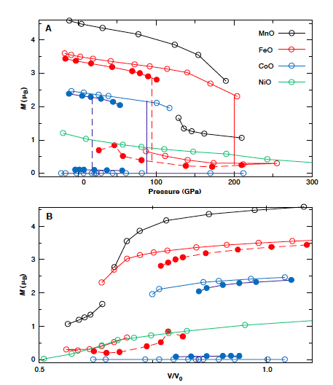
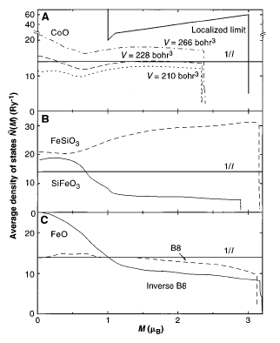
Extended Stoner model
Increase in bandwidth causes spin collapse:

Slide 6
Magnetic collapse vs. High-spin low-spin transition vs. Orbital ordering in FeO
t2g
eg
eg
t2g
t2g
Moment 4μB
4 t2g 2 eg
Moment 0
6 t2g

Slide 7
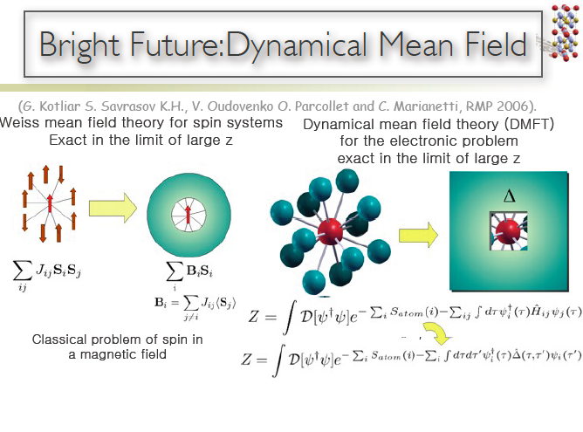

Slide 8
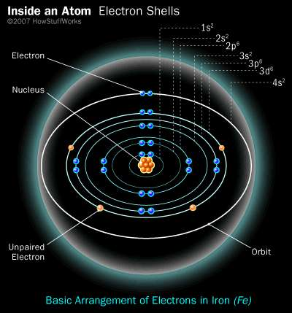
LDA-DMFT
Lattice Problem (contains geometry)
Fully self-consistent, finite temperature
Lattice Problem (DFT) LAPW
Atomic Problem
(Many-body theory: DMFT)
New density
Impurity Model (CTQMC)
Gimp
HDFT

Slide 9

DFT-DMFT
Crystal problem
“Impurity” problem
Self-consistency condition
Kristjan Haule DFT-DMFT code:
integrates wien2k LAPW code for Crystal with Continuous Time Quantum Monte Carlo (CTQMC) for impurity
Fully self-consistent in charge density ρ, chemical potential μ, impurity levels Eimp, hybridization Δ, and self-energy Σ.
Calculations are done on imaginary frequency ω axis, and analytically continued to real axis.
No down folding, fully self-consistent

Slide 10
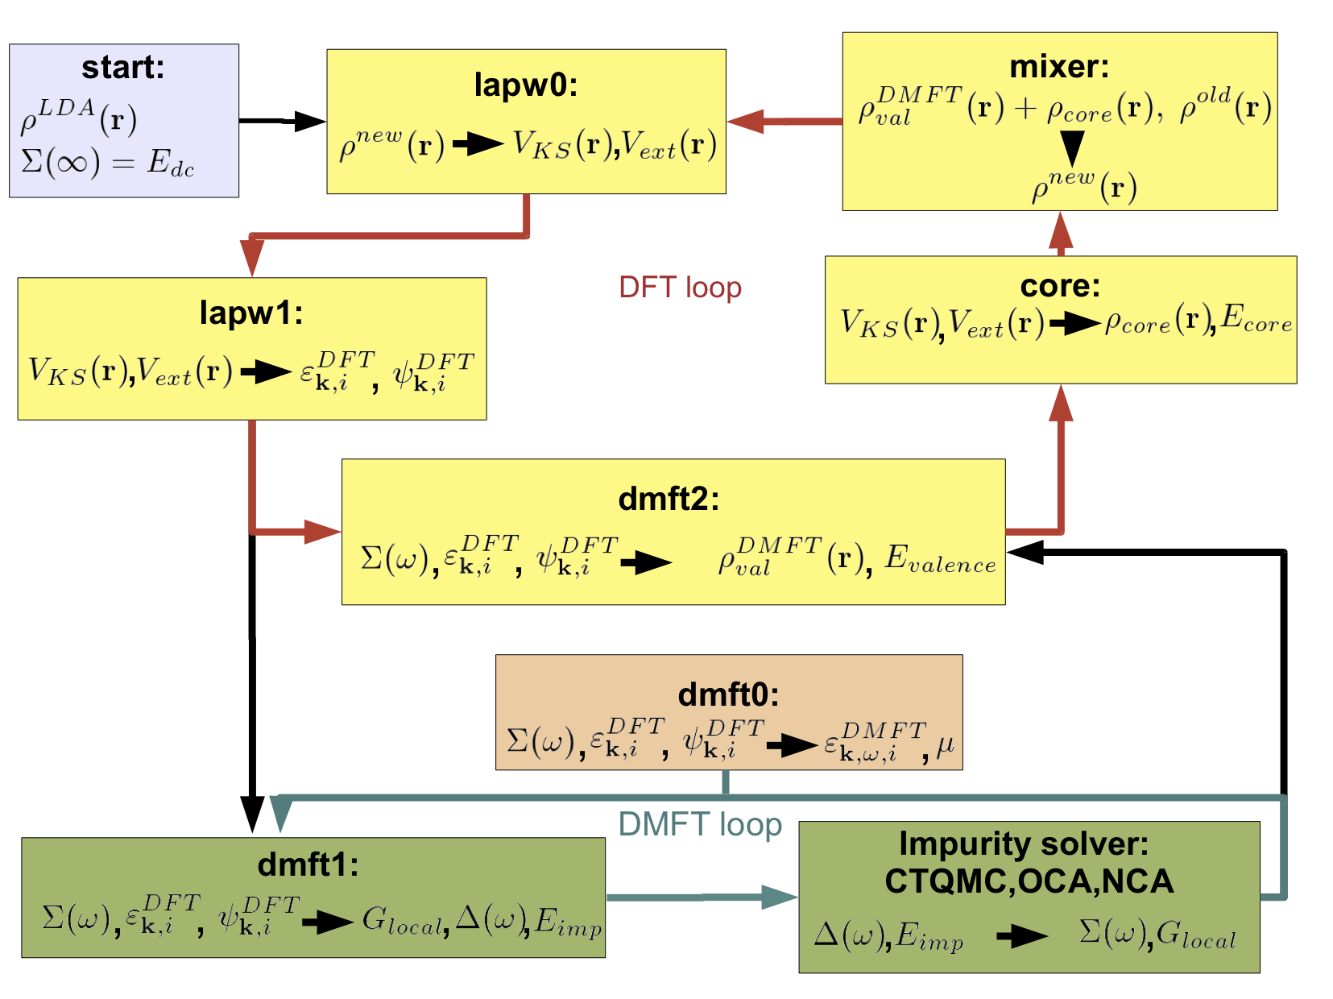
Haule

Slide 11
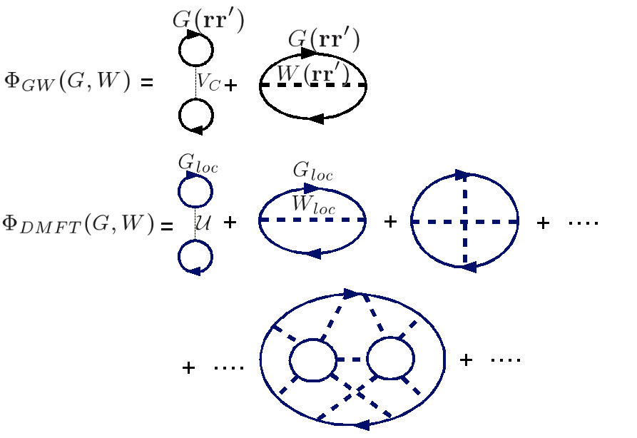
Continuous Time Quantum Monte Carlo (CTQMC)
QMC over Feynman diagrams
Imaginary time (frequency)
Haule

Slide 12
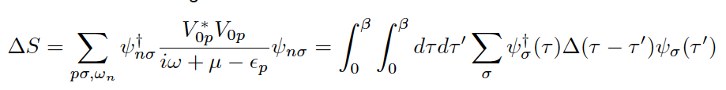
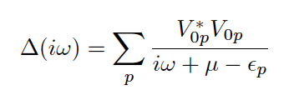
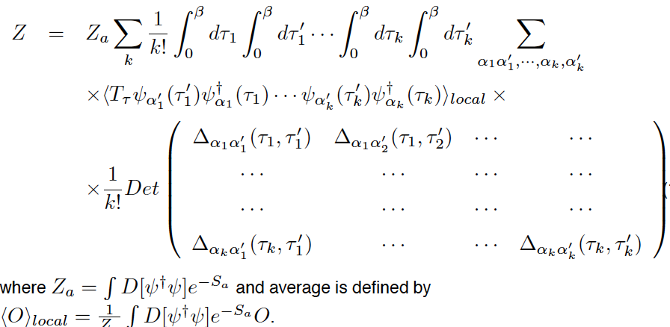
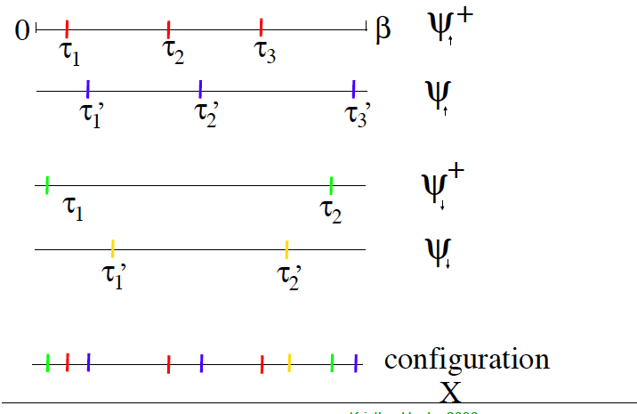
CTQMC
β
0

Slide 13
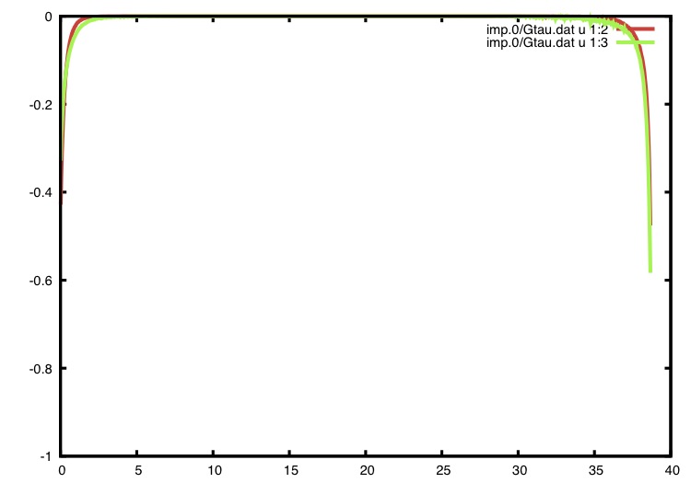
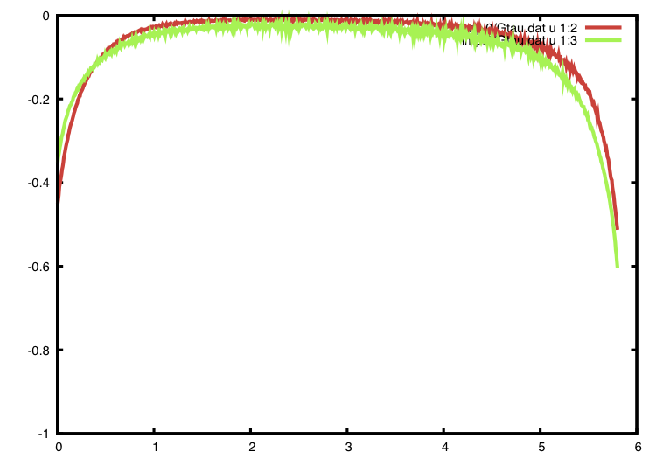
Imaginary Time Gf V=540au
DOS at Ef=0
DOS at Ef≠0
eg
eg
G
G
t2g
t2g
300K
2000K
occupancy
it
40
0
it
6
0

Slide 14
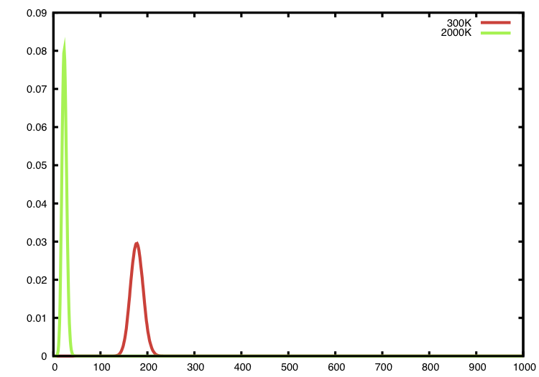
Histogram of number of kinks on Feynman diagrams
V/V0=1, High Spin
2000K
300K
Number of kinks
0
500
1000

Slide 15
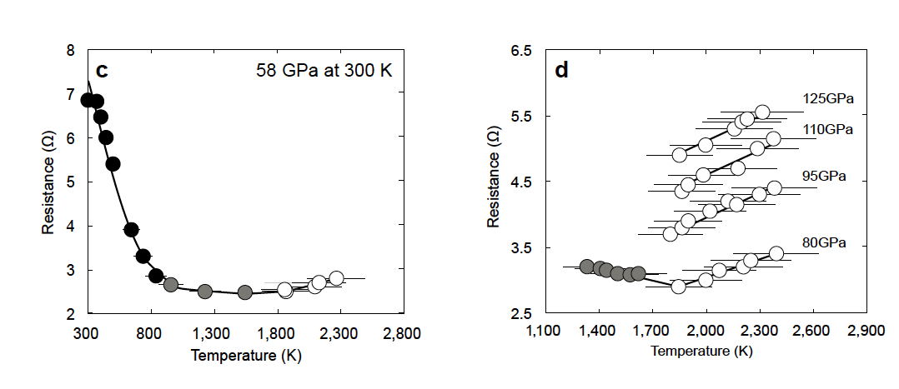
Experimental evidence of metallization at high P and T
Kenji Ohta, Katsuya Shimizu, Osaka University, Yasuo Ohishi, Japan Synchrotron Radiation Research Institute, Kei Hirose, Tokyo Institute of Technology
Ohta, Cohen, et al., PRL 2012

Slide 16
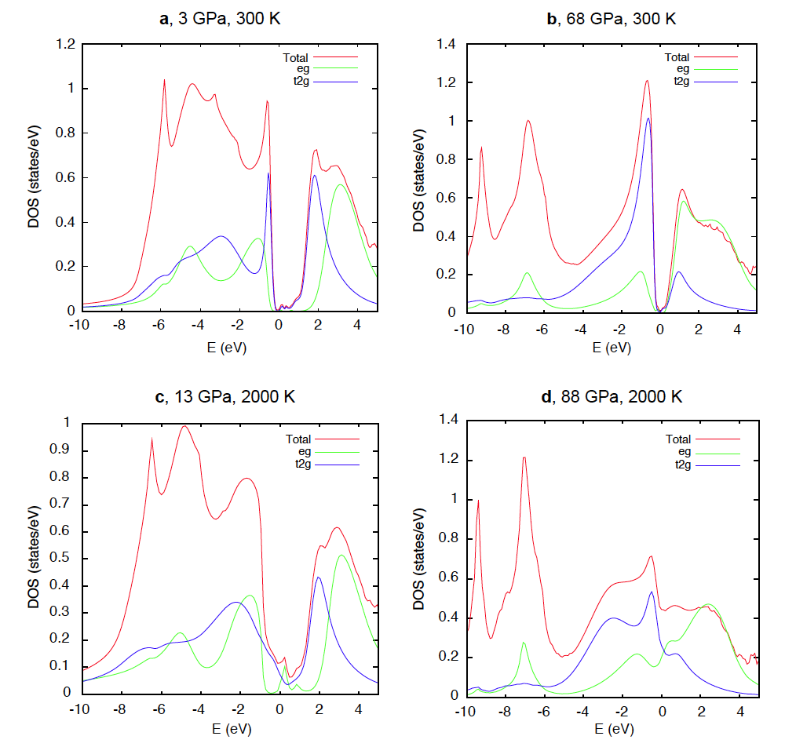
FeO Density of States
Ohta et al., 2011

Slide 17
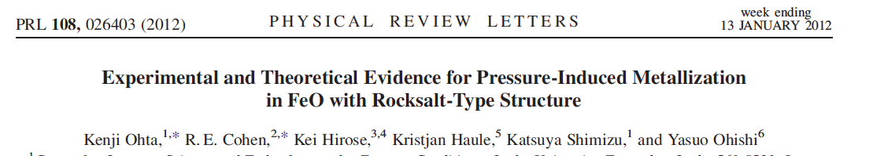
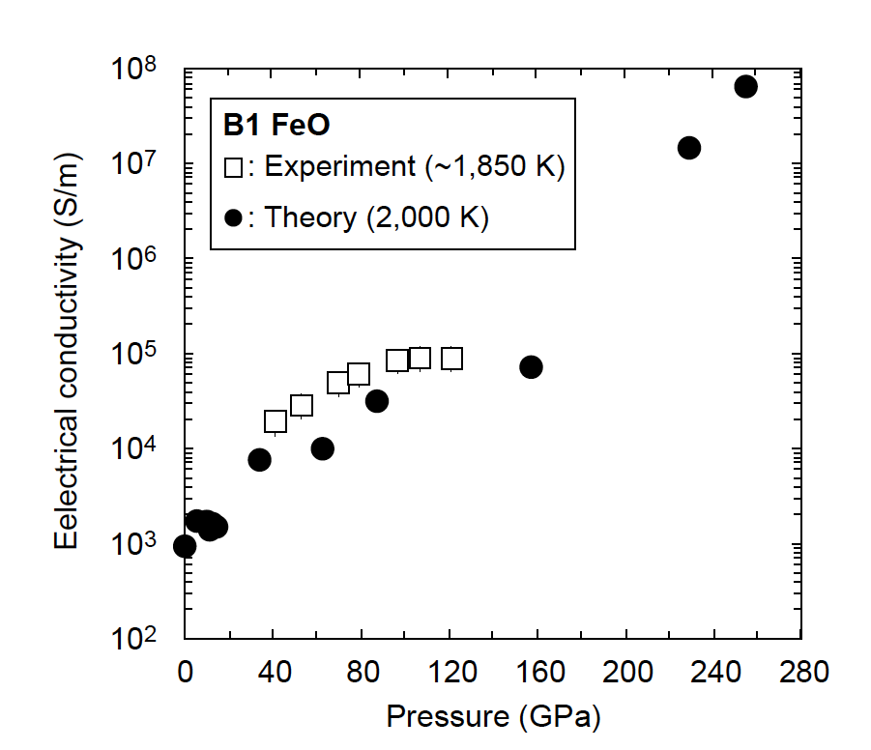


DC conductivity versus pressure

Slide 18
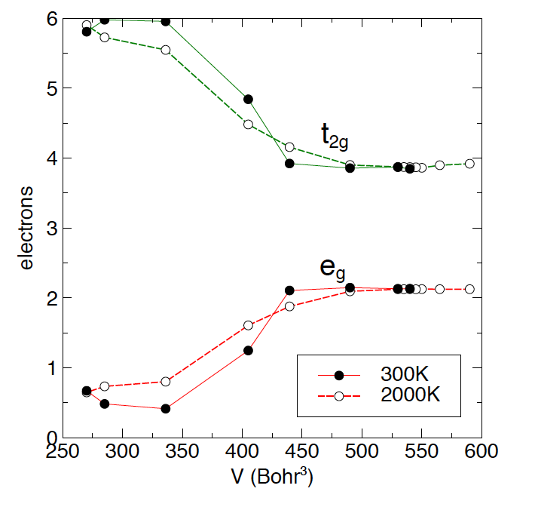
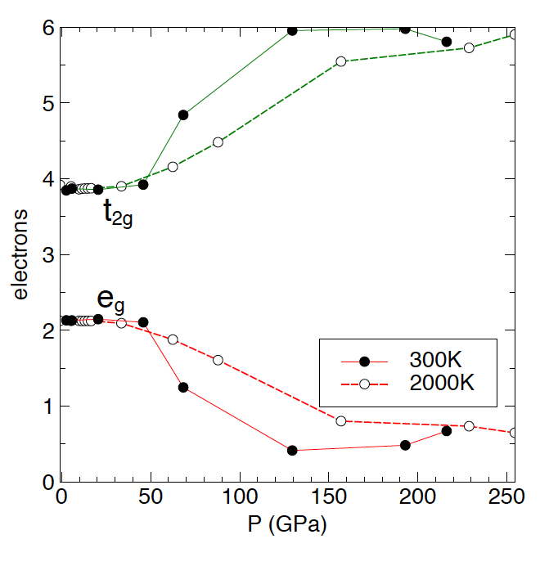
DMFT orbital occupancy transition (HS-LS crossover)
Using experimental equation of state:
from Fischer et al. EPSL 2011

Slide 19
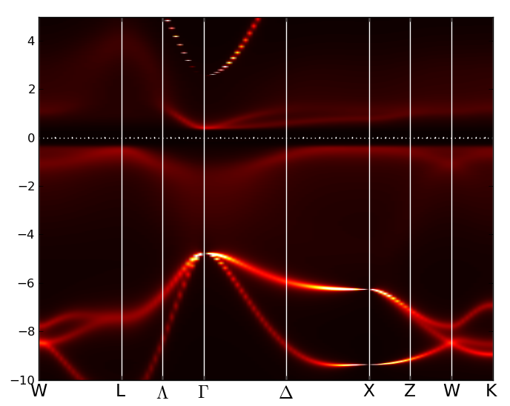
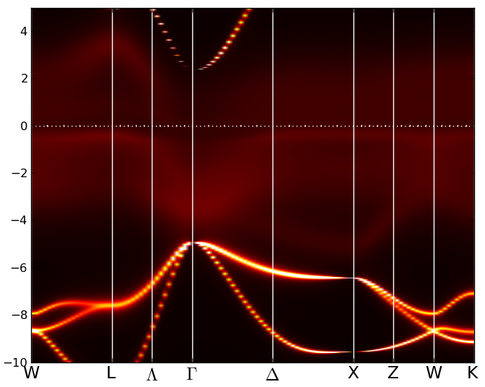
Spectral Function A(k,ω)
V=405 au, V/V0=0.75, 68 GPa 300K
V=405 au, V/V0=0.75, 88 GPa 2000K
Low spin insulator -> low spin metal

Slide 20
High spin at low P
V=540 au, V/V0=1
eg2 t2g4
HS
d5
d7

Slide 21
Spin fluctuations ➔ metallization
V=405 au, V/V0=0.75, 68 GPa 300K
V=405 au, V/V0=0.75, 88 GPa 2000K
eg0 t2g6
LS
HS
eg2 t2g4

Slide 22
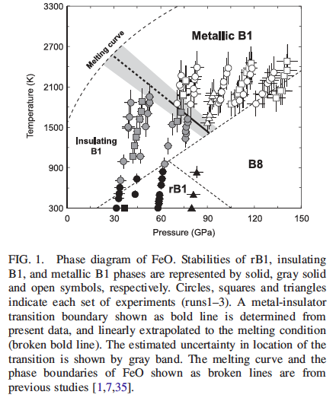
FeO phase diagram 1/12
Ohta, Cohen, et al., PRL, 2012

Slide 23
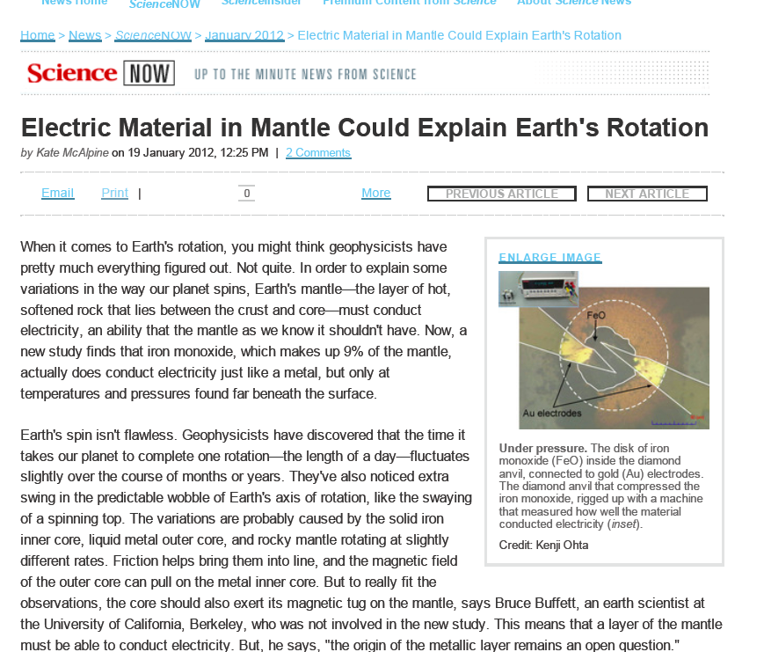
A new kind of metal in the deep Earth - Worldnews.com
article.wn.com/view/ A_new_kind_of_metal_in_the_deep_Earth/
Dec 19, 2011 – Read full article. Back to 'A new kind of metal in the deep Earth' .... 10 years ago, Ronald Cohen had made a name for himself in private equity.

Slide 24
Summary
DFT-DMFT computations show metallization in FeO at high P and T
  Temperature is crucial.
  Metallization is due to fluctuations between high-and low-spin states.
  Self-consistency is crucial.
  Excellent agreement with experiment.

